Slide 1


Slide 2
Schedule
Opening Remarks
Abdulbasit Kassim - Between Silence and License
Ghulam Kehar - Beyond Refugee Resettlement
Sam Sun, MD - Cancer in a Box
Rengin Akillioglu - The Power of Emotions
Houston VIP Slam
Lunch
Nancy Niedzielski – What We Don’t Know We Know
Lisa Helfman - Nourish to Flourish
Weijie Violet Lin - Memory is Creative
Closing Remarks

Slide 4
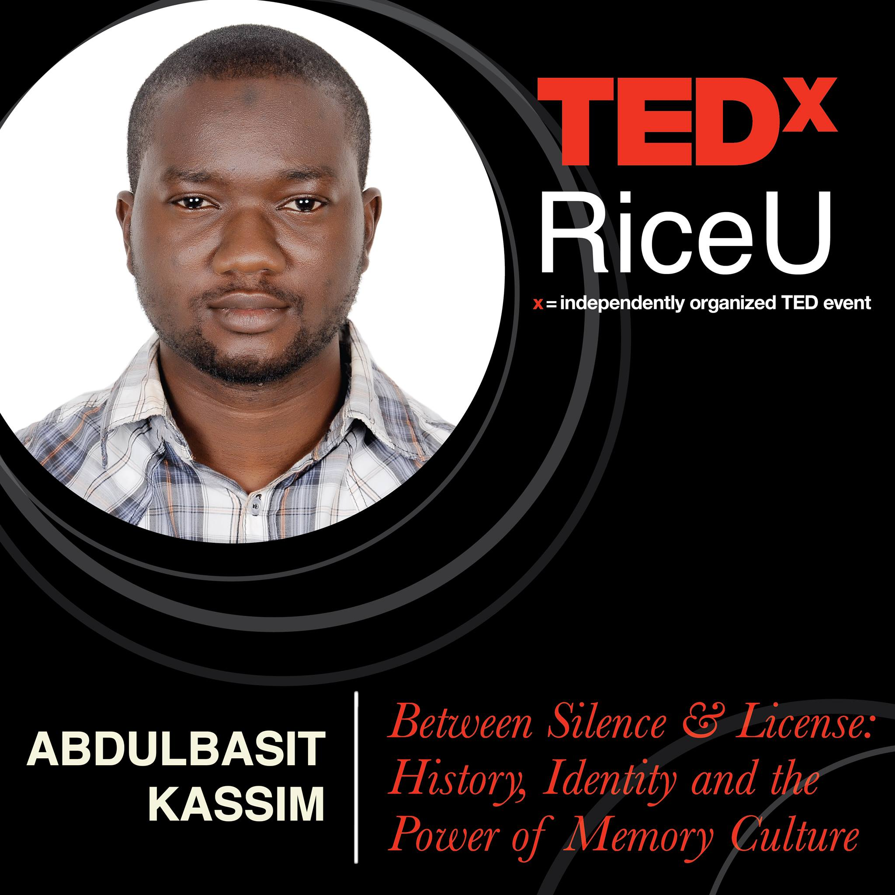

Slide 5
Tell me , dear ones…WHAT IS HISTORY? Come up with your own definition of History!

Slide 6
The Concentric Circles of History
Everything that ever happened

Slide 7
The Concentric Circles of History
Happened
Everything that was ever seen

Slide 8
The Concentric Circles of History
Happened
Seen
Everything that someone recorded

Slide 9
The Concentric Circles of History
Happened
Seen
Recorded
Every record that survived

Slide 10
The Concentric Circles of History
Happened
Seen
Recorded
Survived
Everything that we’ve found

Slide 11
The Concentric Circles of History
Happened
Seen
Recorded
Survived
Found
Everything we’ve decided to agree upon

Slide 12
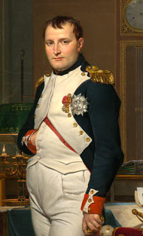
“History is the version of the past events that people have decided to agree upon.”
-Napoleon Bonaparte
But how exactly do we settle upon the story that is told in our history textbooks, archives, museums, and historical monuments?
Notes:
What are some reasons for bias? Vested interest, taking a side, revisionist history, etc…

Slide 13
What if the history we’ve decided to agree upon does not accurately reflect the truth?

Slide 14
Missing in History Textbooks?

Slide 15
Culture of Public Apology
Restoration of a moral balance and equality of regard
Acknowledgement of a wrong committed, including the harm it has caused and a commitment, explicit or implicit, to non-repetition of the wrong.

Slide 16
History and Memory
“In celebrating Black History Month, we can take satisfaction from this recent progress in the realization of the ideals envisioned by our Founding Fathers. But, even more than this, we can seize the opportunity to honor the too-often neglected accomplishments of black Americans in every area of endeavor throughout our history.” President Gerald Ford
Notes:
Discuss the limitations of oral history

Slide 17
A Thought to Keep in Mind…
THERE ARE MANY SIDES TO EVERY STORY

Slide 19


Slide 21


Slide 22
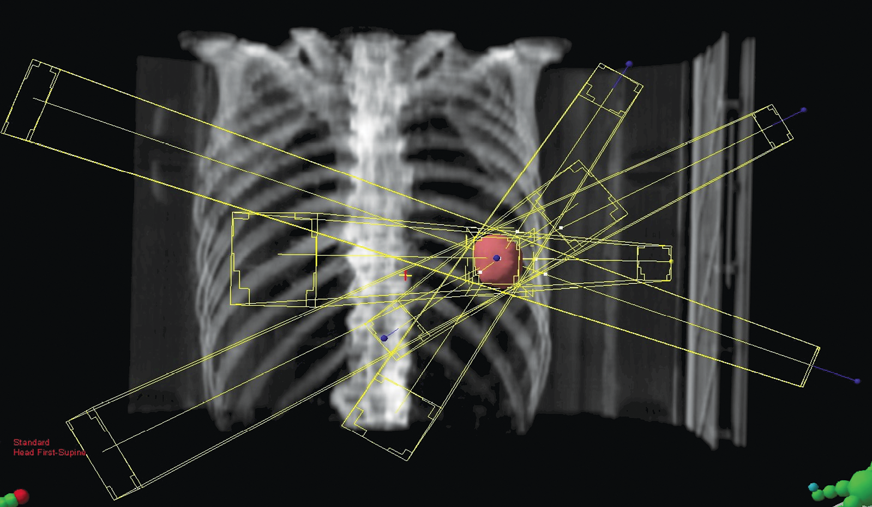
“You can’t cure [cancer] if it doesn’t fit in a box”
Notes:
Talk about cancer in a box…

Slide 23
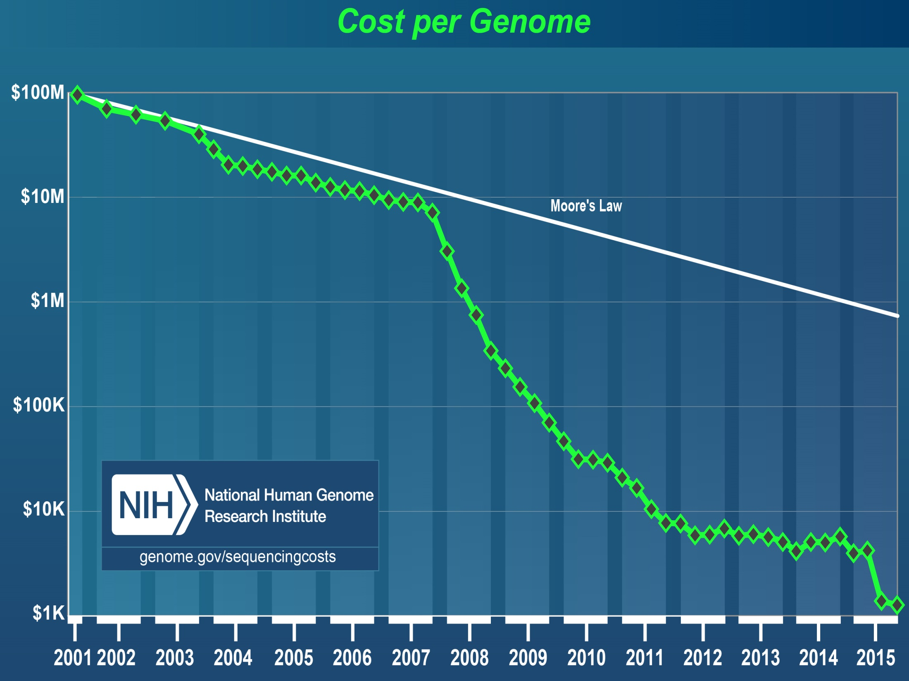

Slide 24
sequencing of 1st cancer genome
sequencing of 3000+ cancer genomes

Slide 25
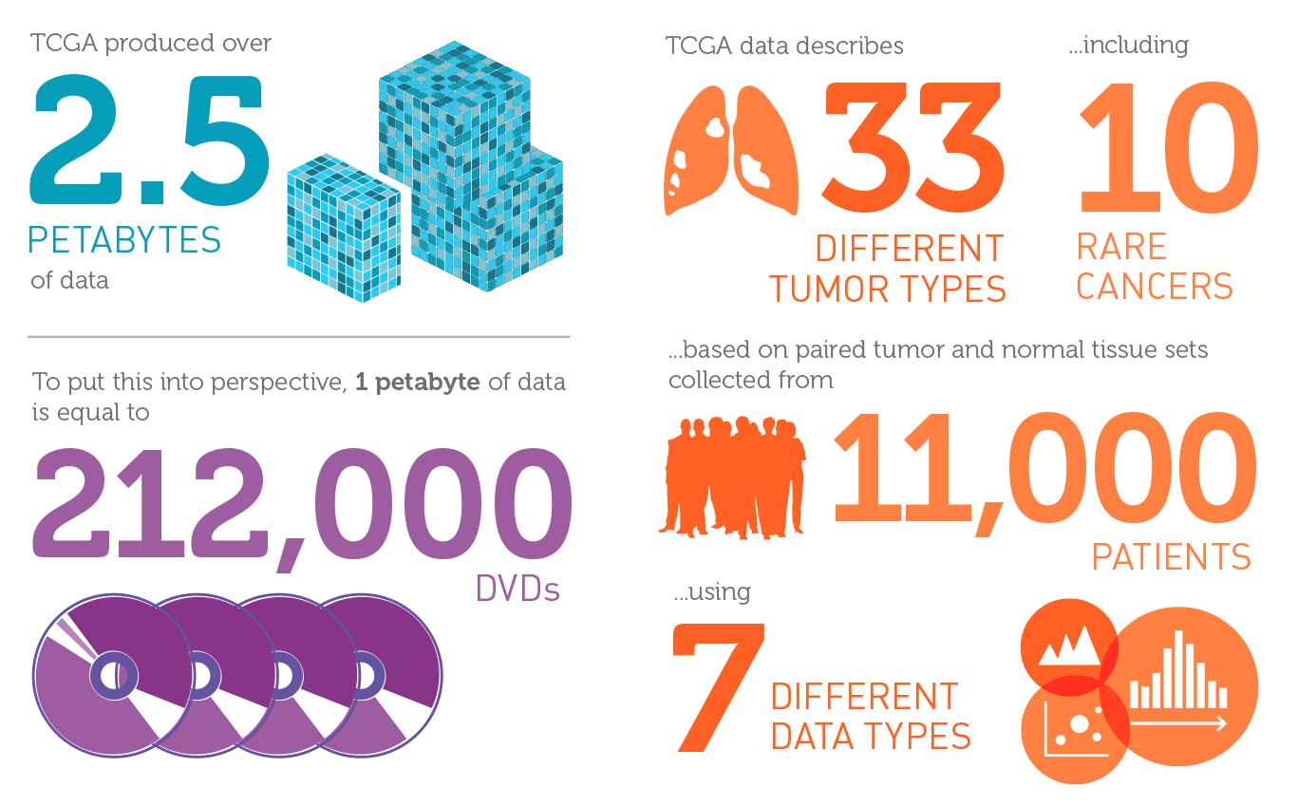
Notes:
Cancer genome – so, what’s the point?
Circle back to this
More theory & conclusions, less stories

Slide 26
What do we do with all this data?
Notes:
Cancer genome – so, what’s the point?
Circle back to this
More theory & conclusions, less stories

Slide 27
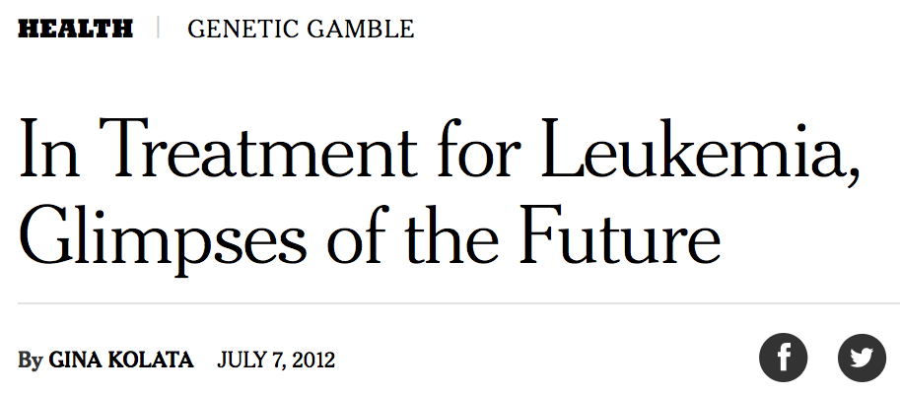
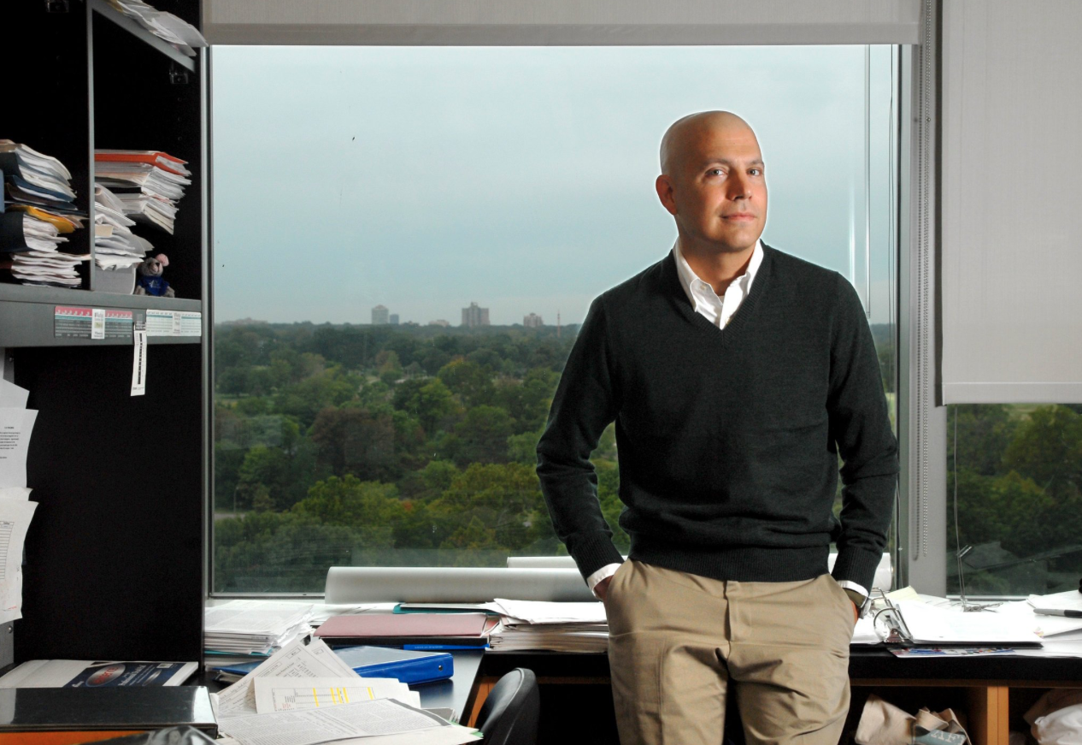
Notes:
Insert Lukas Wartman’s fish plot after this

Slide 28
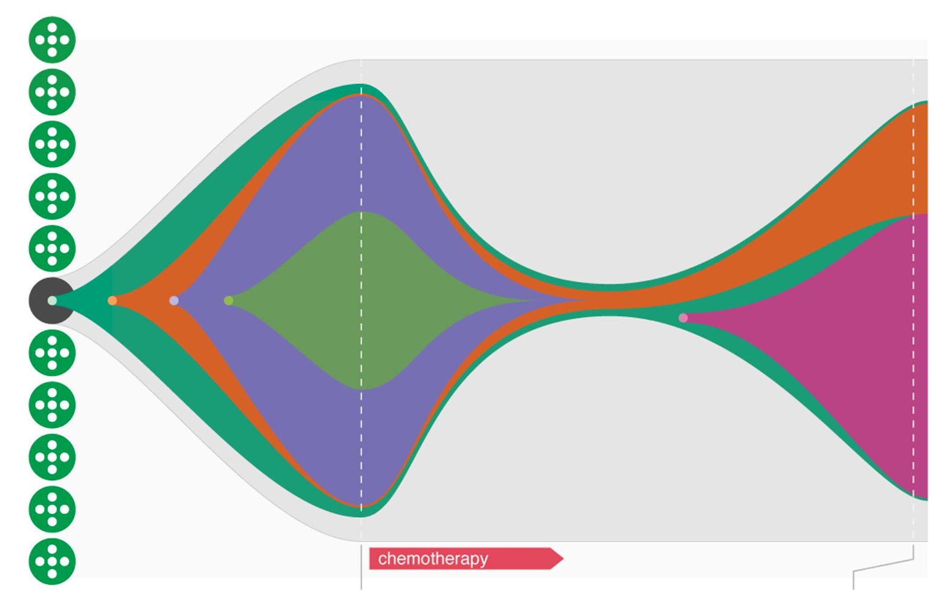
Leukemia (initial)
Leukemia (relapse)
chemotherapy
Notes:
He took really long on this slide??

Slide 29
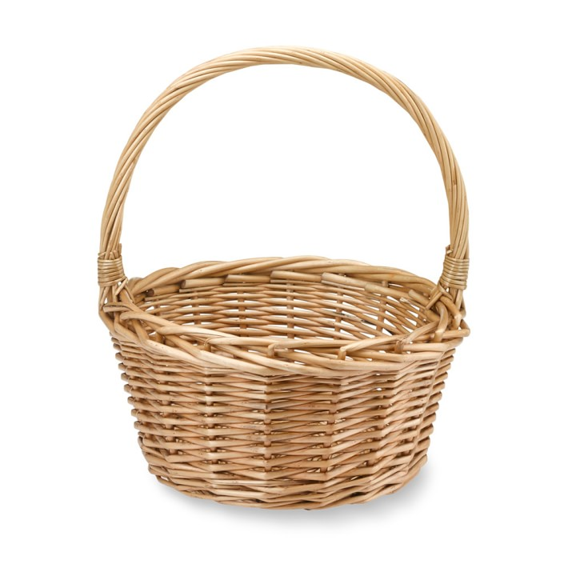
lung
cancer
basket trial for a genetic mutation
breast
cancer
colon
cancer
trial drug
Notes:
Basket trials??

Slide 30
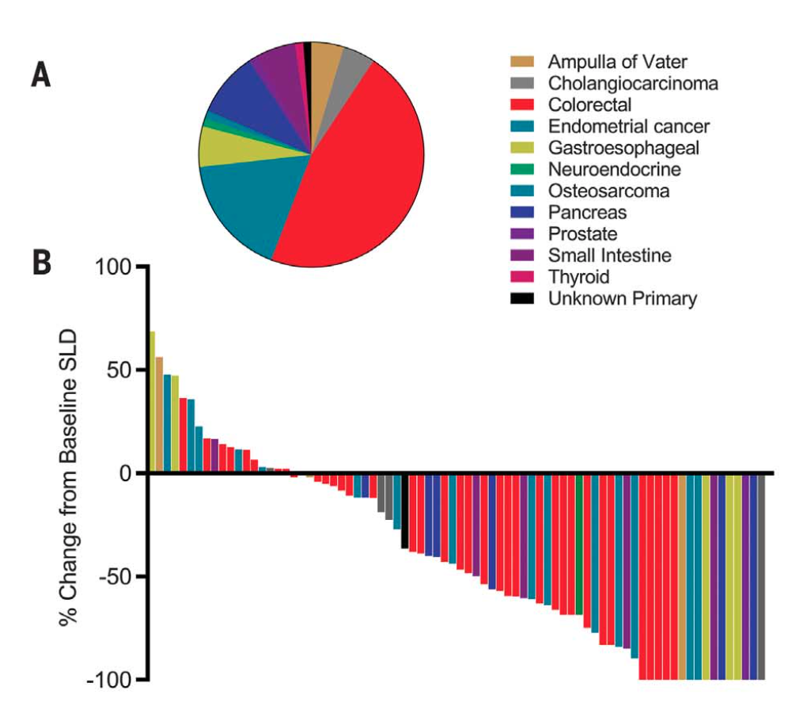
Effect of treatment on cancers with microsatellite instability
% change in size with treatment
Notes:
MSI, Loxo (TRK)
Animate and show one at a time
Pancreatic neuroendocrine tumor (stage IV) … Facebook

Slide 31
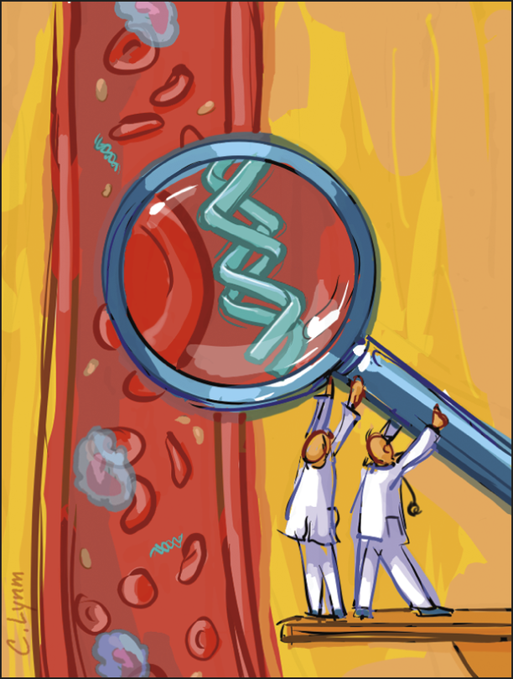

Slide 32
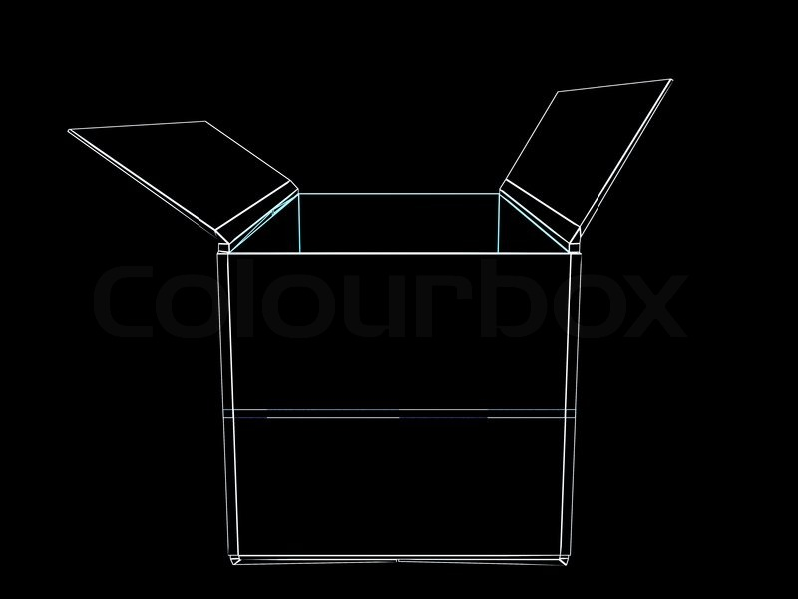
Cancer in a box
Notes:
Radiotherapy
Tim Ley & 1st cancer genome (sequencing costs) & NYT & TCGA
Targeted therapy
Immunotherapy (microbes & cancer)
Circulating tumor DNA
Less background, more your new idea – cancer & technology
Focusing too much on what past people have said…so get rid of these slides

Slide 33
Cancer in a box
Notes:
Radiotherapy
Tim Ley & 1st cancer genome (sequencing costs) & NYT & TCGA
Targeted therapy
Immunotherapy (microbes & cancer)
Circulating tumor DNA
Less background, more your new idea – cancer & technology
Focusing too much on what past people have said…so get rid of these slides

Slide 35
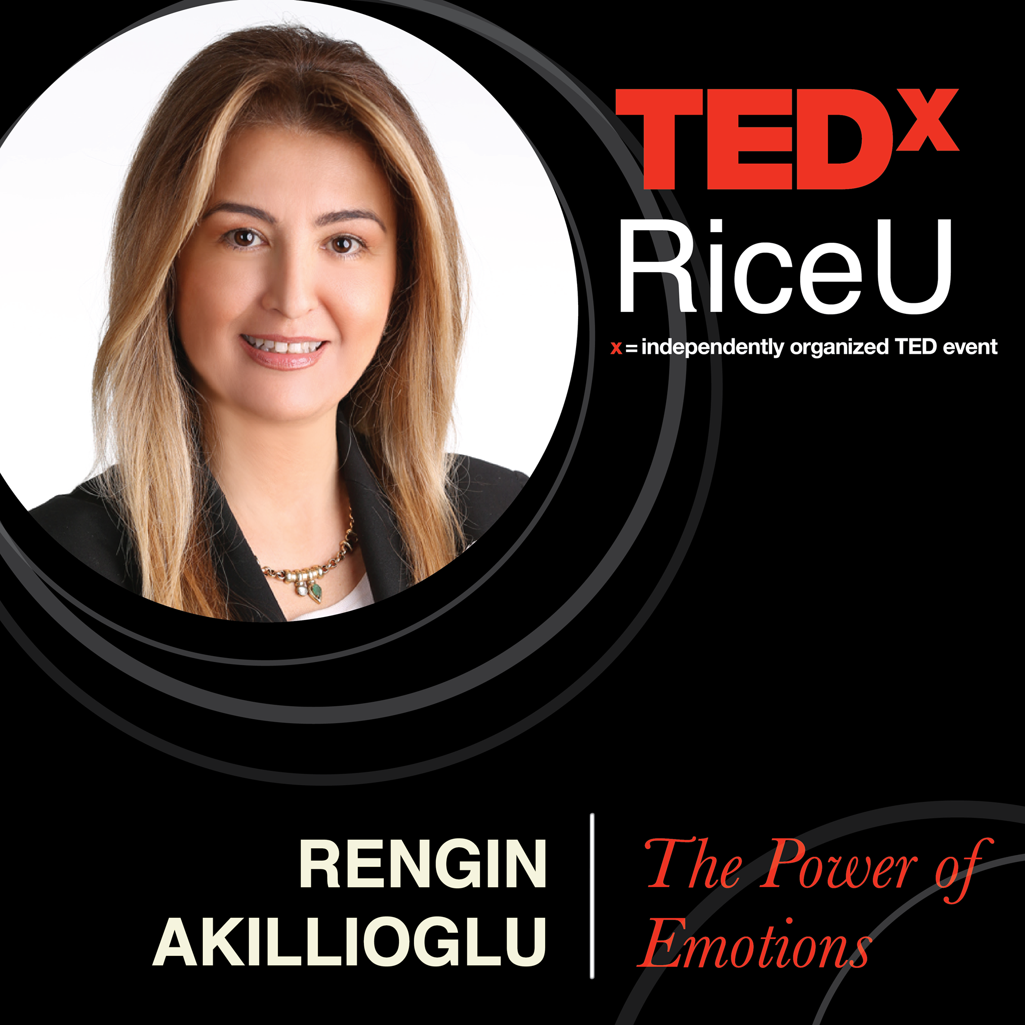

Slide 36
EMOTIONS
Were not only the end results of our experiences but were also the seeds of them
Play important role in changing our beliefs thereby the outcomes and our outer experiences

Slide 37
exits in the universe
The future
The dreams
Physical world
Non-physical world
Everything

Slide 38
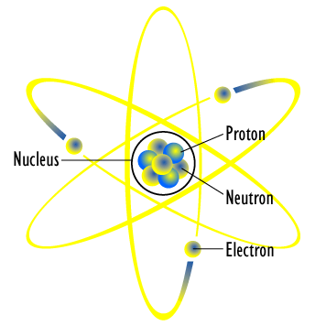
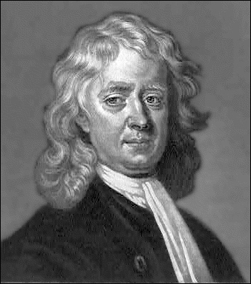
Up until 19th century
Newtonian’s Material Universe: Atom is a Tangible Matter

Slide 39
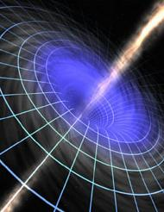
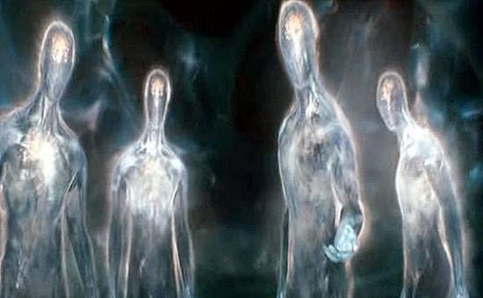
At the turn of 19th century
Atom is
Vortices of energy
Radiating unique energy signature
Existing in different places and time zones simultaneously
All connected
We are made up of invisible energy not a tangible matter

Slide 40

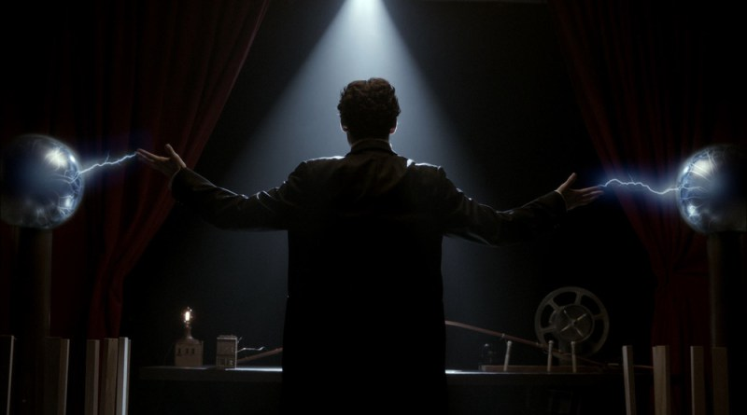
This is a vibrational universe
Physical and non-physical world – ALL CONNECTED
Perceiving everything with the ability to interpret vibration
This Photo by Unknown Author is licensed under CC BY-NC
This Photo by Unknown Author is licensed under CC BY-NC
This Photo by Unknown Author is licensed under CC BY-NC

Slide 41

Vibrational interpreter
EMOTIONS
This Photo by Unknown Author is licensed under CC BY-NC

Slide 42
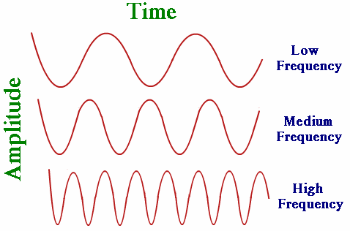
Everything
is in a constant state of motion
Frequency = Rate of vibration
Thoughts + Emotions = Highest form of vibration

Slide 43
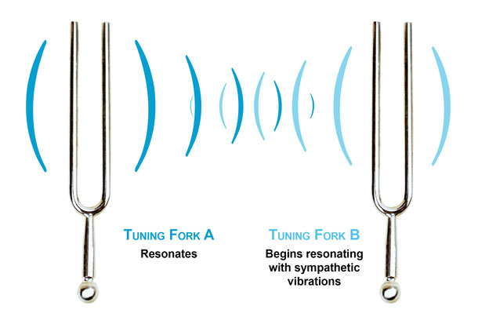
Vibrational alignment
Matching of vibrational frequencies
Call up the feeling you will have when it comes true
Include emotions into your dreams

Slide 44
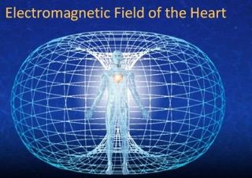
Feeling is the SECRET
“A change in a feeling is a change in destiny”
Neville Goddard
Feel- Vibrate to- Create frequency
Positive Feeling
The more intense feeling => The faster dream comes true
“What you think about; activates a vibration within you”
Abraham Hicks

Slide 45
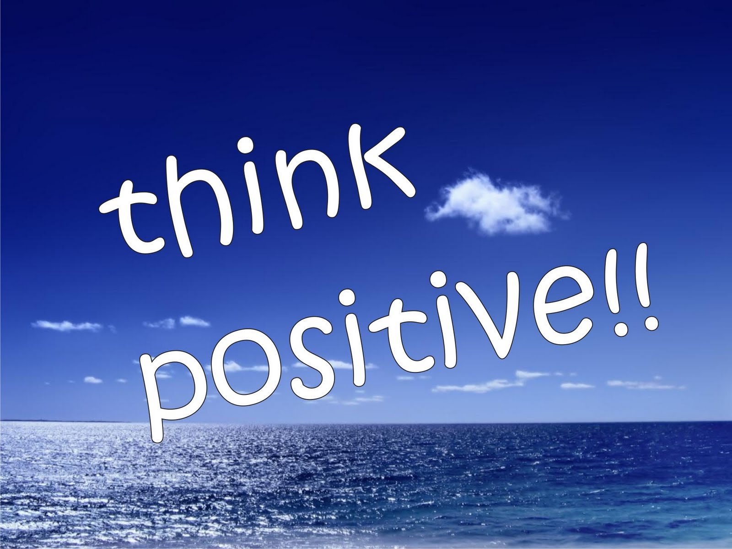

THINK & FEEL POSITIVELY
VISUALIZE
THINK POSITIVE (no doubt or anxiety)
FEEL AS IF YOUR DREAM ALREADY CAME TRUE
TO BE IN A GOOD STATE OF VIBRATION

Slide 46
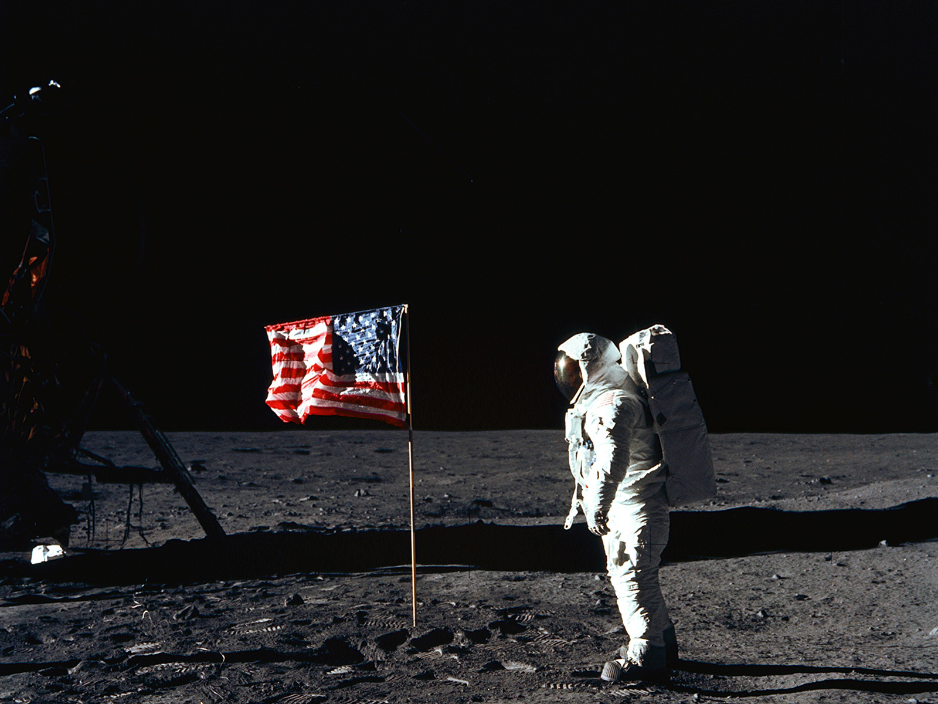
Dream
Of the impossible to achieve

Slide 47
BELIEF
THOUGHT + EMOTION

Slide 48
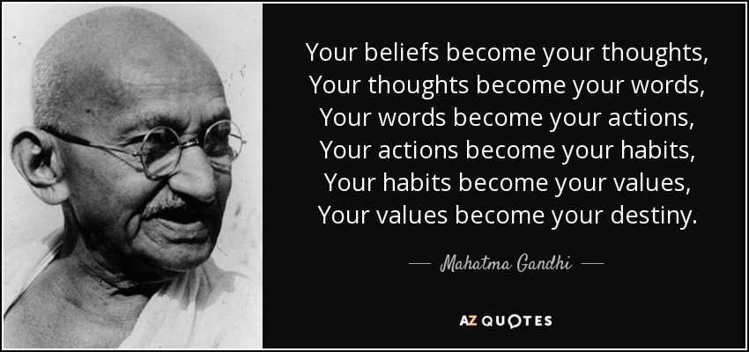

Slide 49


Slide 51
Schedule
Opening Remarks
Abdulbasit Kassim - Between Silence and License
Ghulam Kehar - Beyond Refugee Resettlement
Sam Sun, MD - Cancer in a Box
Rengin Akillioglu - The Power of Emotions
Houston VIP Slam
Lunch
Nancy Niedzielski – What We Don’t Know We Know
Lisa Helfman - Nourish to Flourish
Weijie Violet Lin - Memory is Creative
Closing Remarks

Slide 53


Slide 54
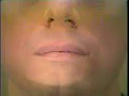
What do you hear?

Slide 55
How do you make a verb past tense in English?
Really? (hug, kiss, wade?)

Slide 56
How do you make a verb past tense in English?
Really? (hug, kiss, wade?)
How about words you never heard before?
mib neep dut

Slide 57
How do you make a verb past tense in English?
Really? (hug, kiss, wade?)
How about words you never heard before?
mib neep dut
How do you make nouns plural? (cat, dog, fish?)
neep mib padge

Slide 58
What am I saying?
We’re at a political event
We’re driving down the coast

Slide 59

What is the last word in each sentence?
bit <------------> bet
F1 of CARRIER SENTENCE
200-380 Hz
380-660 Hz
bet
bit
Ladefoged and Broadbent (1957) JASA 29, 98-104

Slide 60
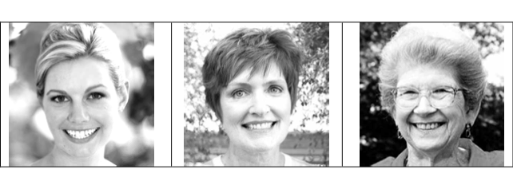
Some people say ‘rinse’ and ‘rents’ the same
Rinse Rents
picture
Rack Rough

Slide 61

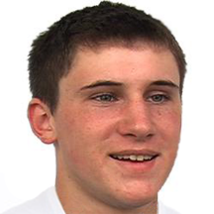
Some people say ‘set’ and ‘said’ (almost) the same
SAID SET

Slide 62
So, perceived age of speaker influences our perception; so does gender, ethnicity, lines on a map, perceived disability
As we saw, vision, pitch of someone’s voice; lots of other things

Slide 63
WHY???
We listen to our interlocutors in imperfect environments; our interlocutors aren’t perfect; we have a LOT of interlocutors (who create in infinite amounts of frequency combinations); human languages are incredibly complex
So, since we have this magnificent, large, complex cerebral cortex, let’s just go ahead and use the whole thing…

Slide 65


Slide 66
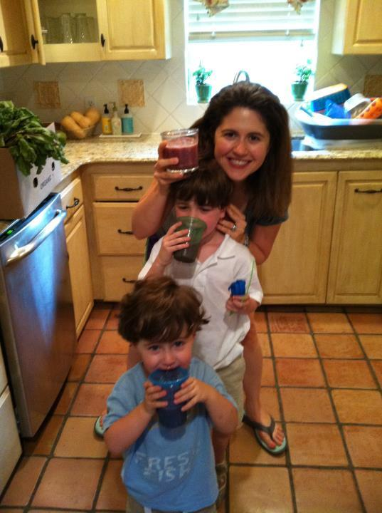

Slide 67
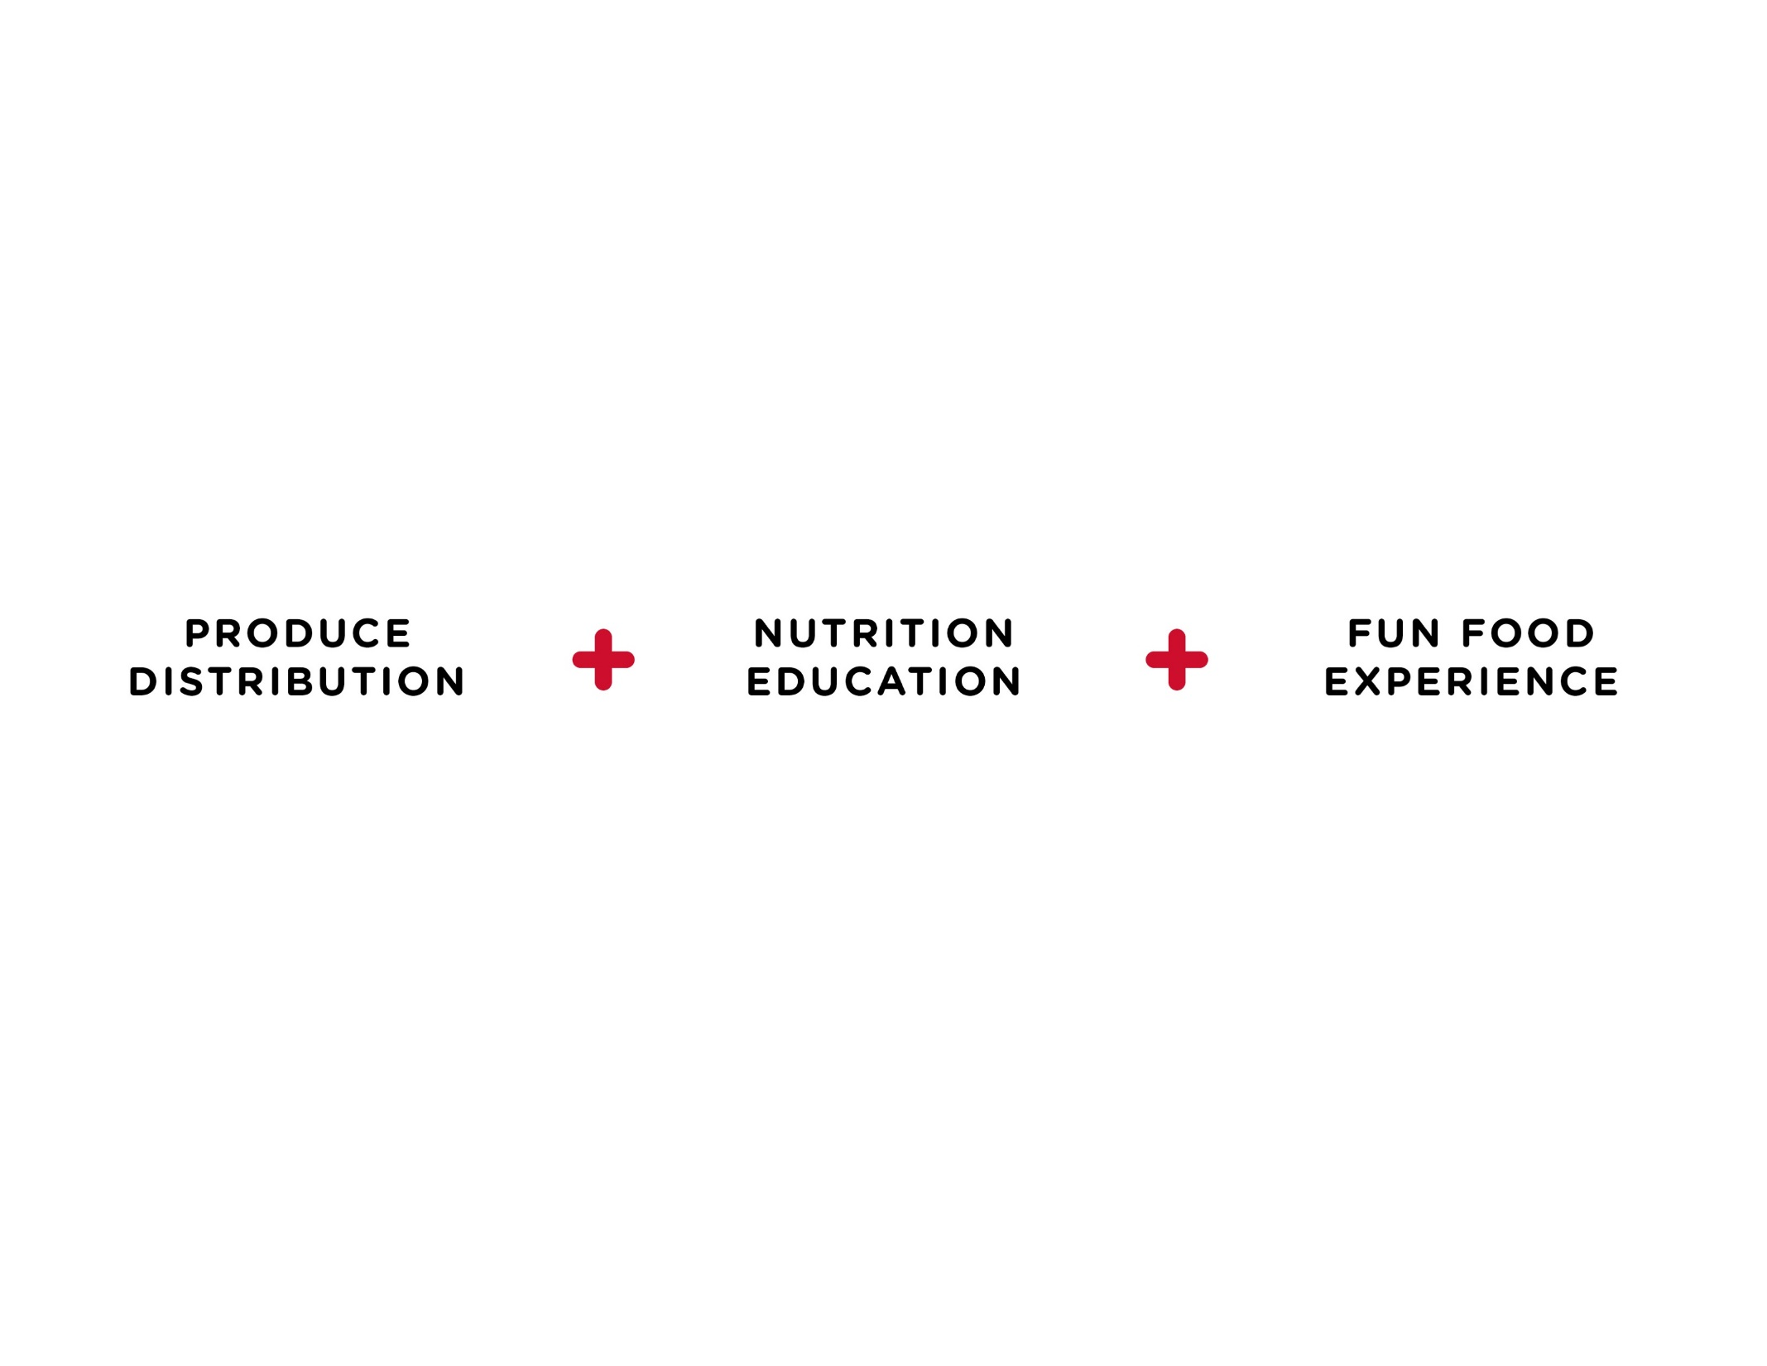
Notes:
Formula Slide

Slide 68
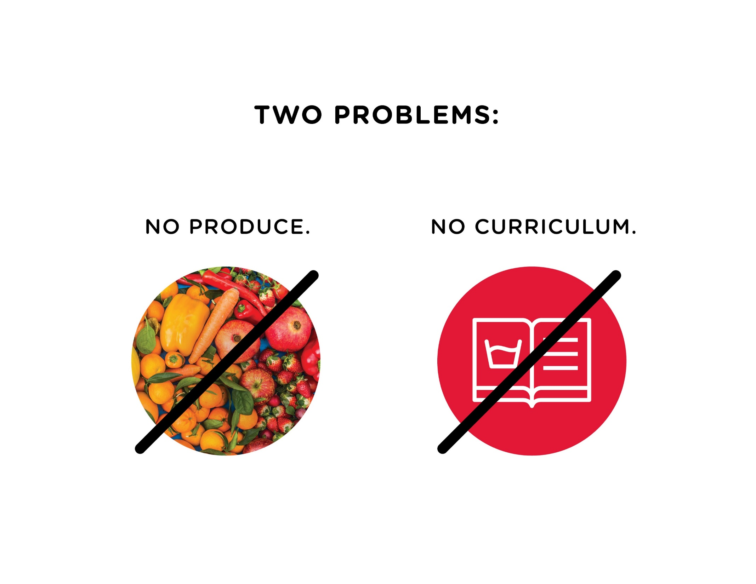

Slide 69
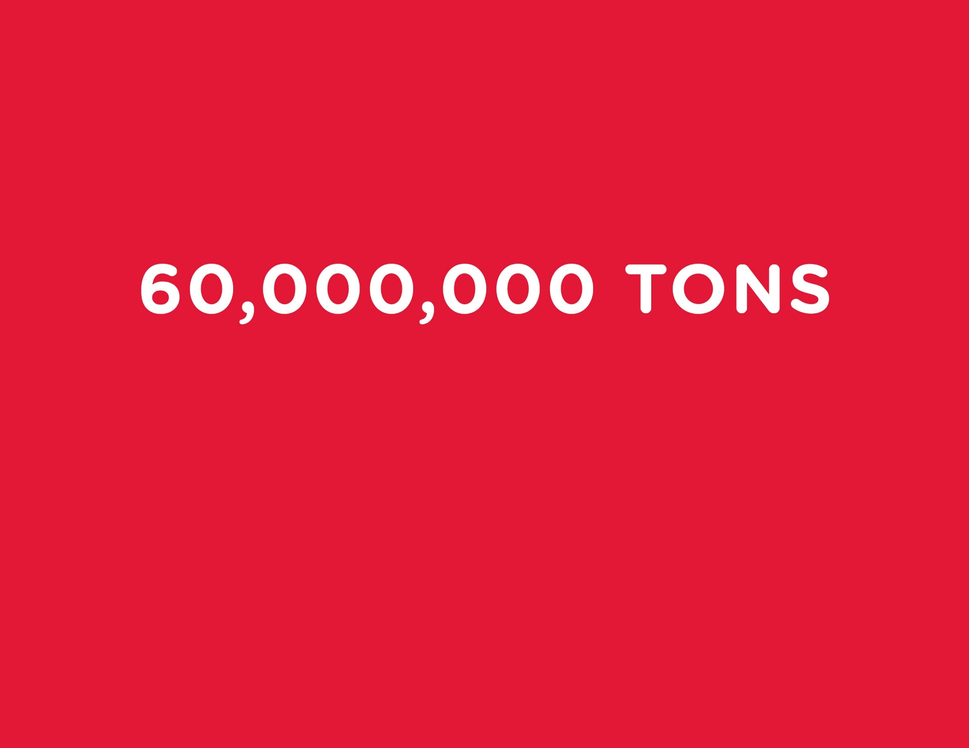

Slide 70
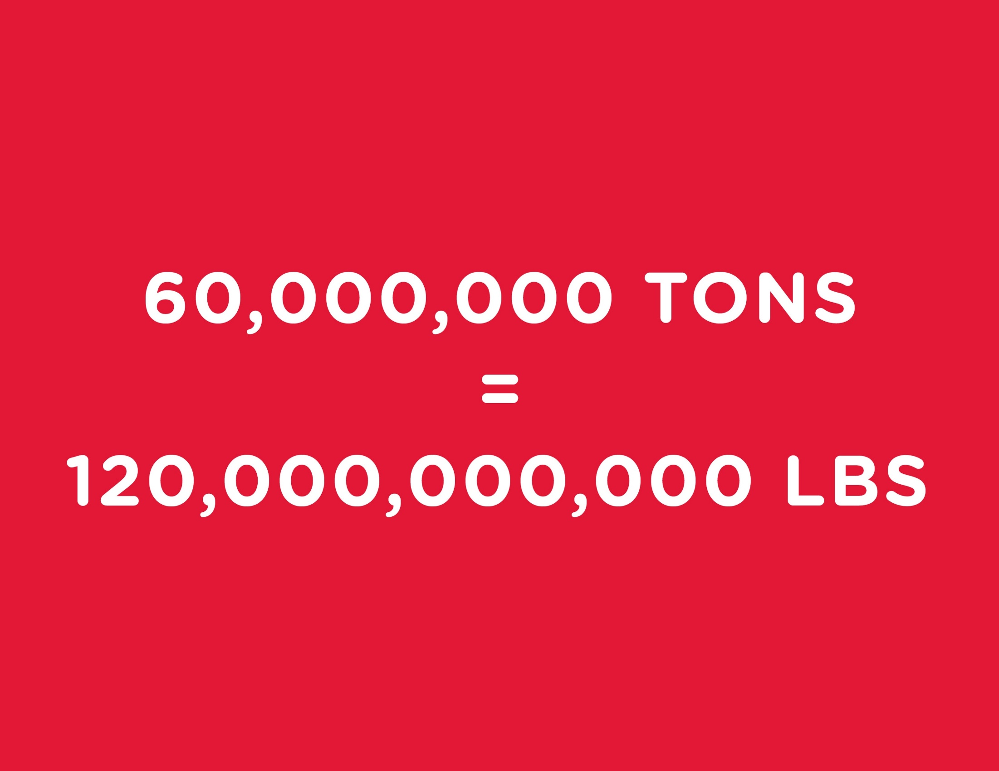

Slide 71
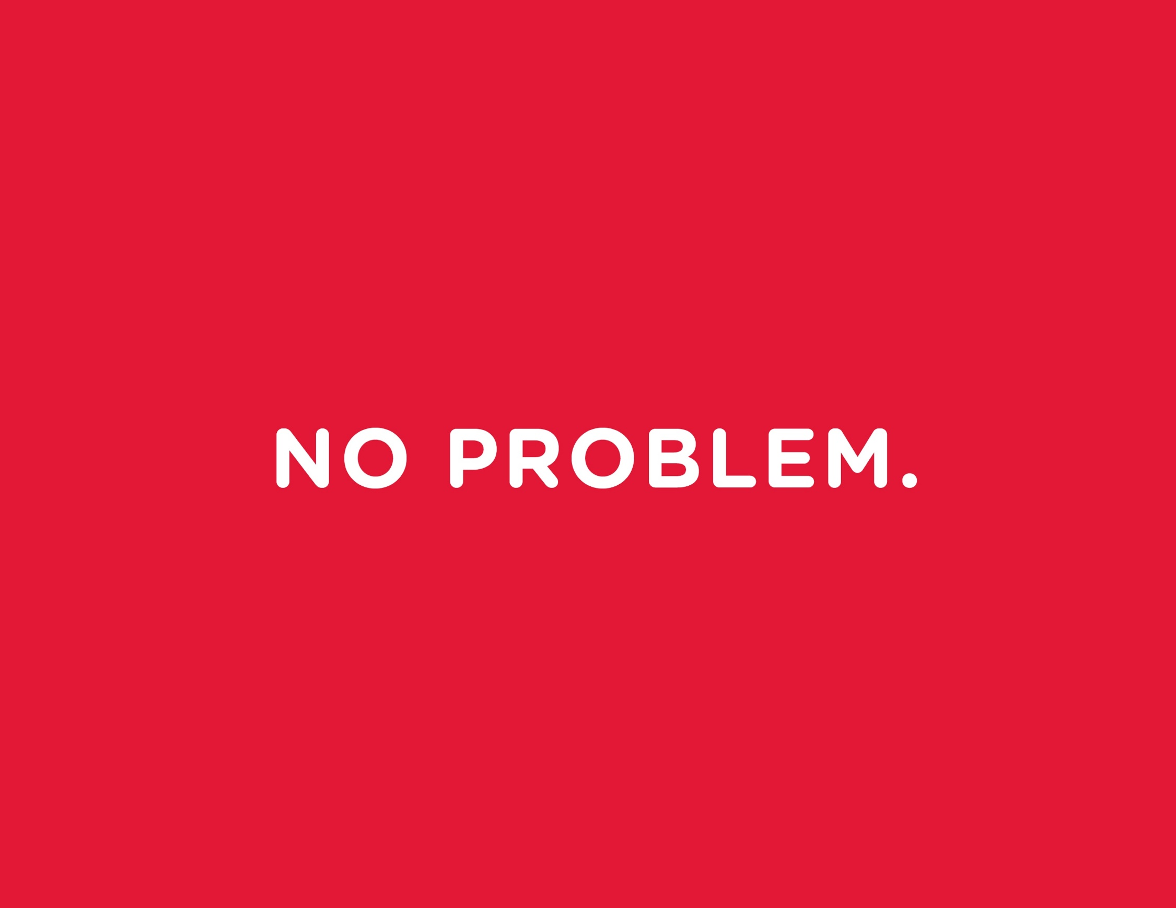

Slide 72
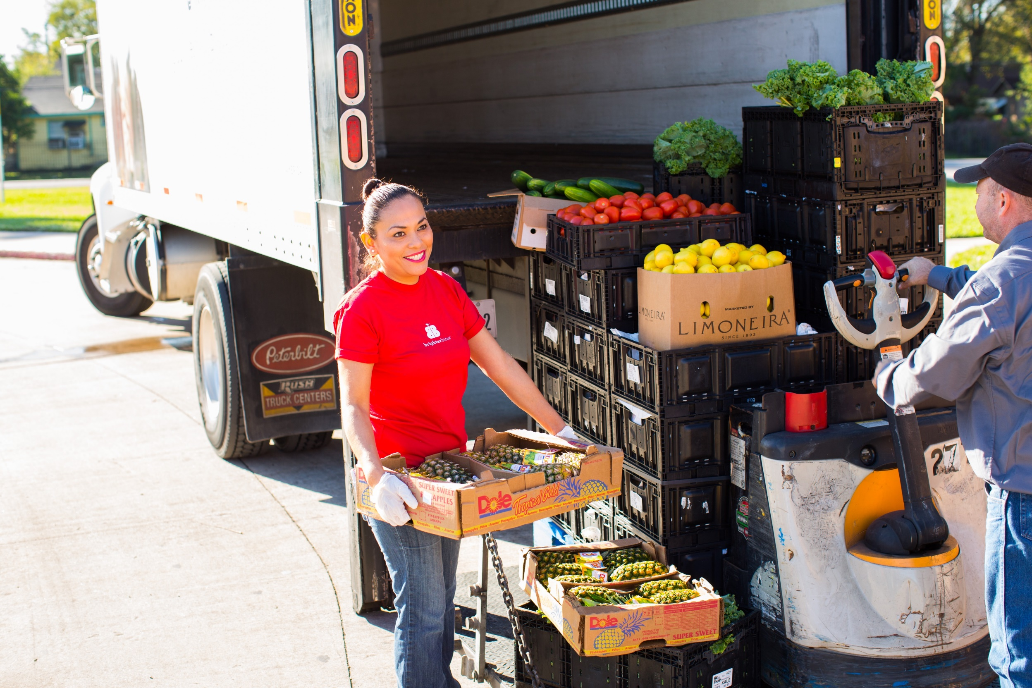

Slide 73
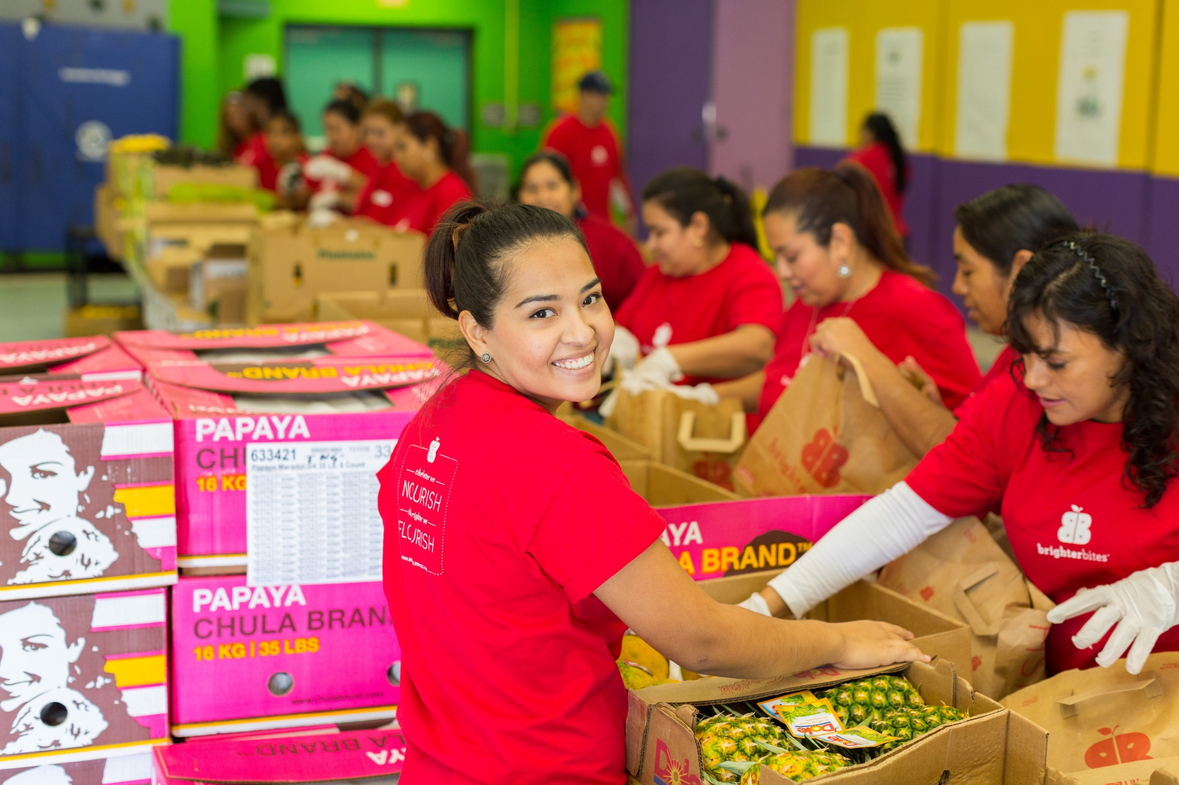

Slide 74
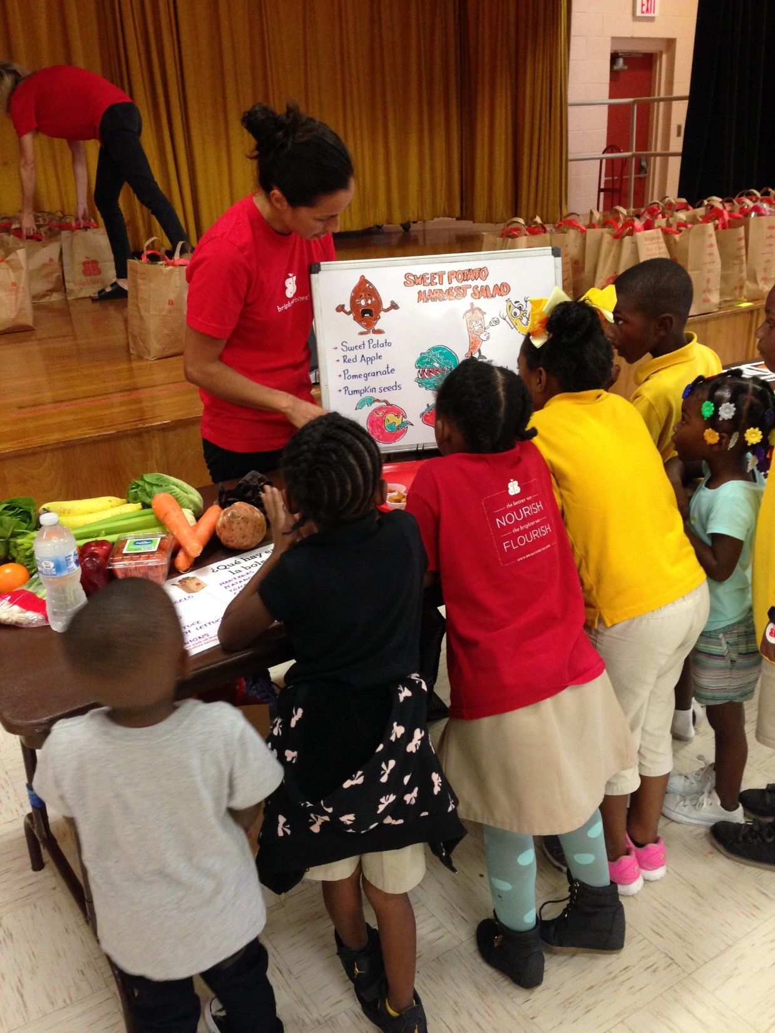

Slide 75
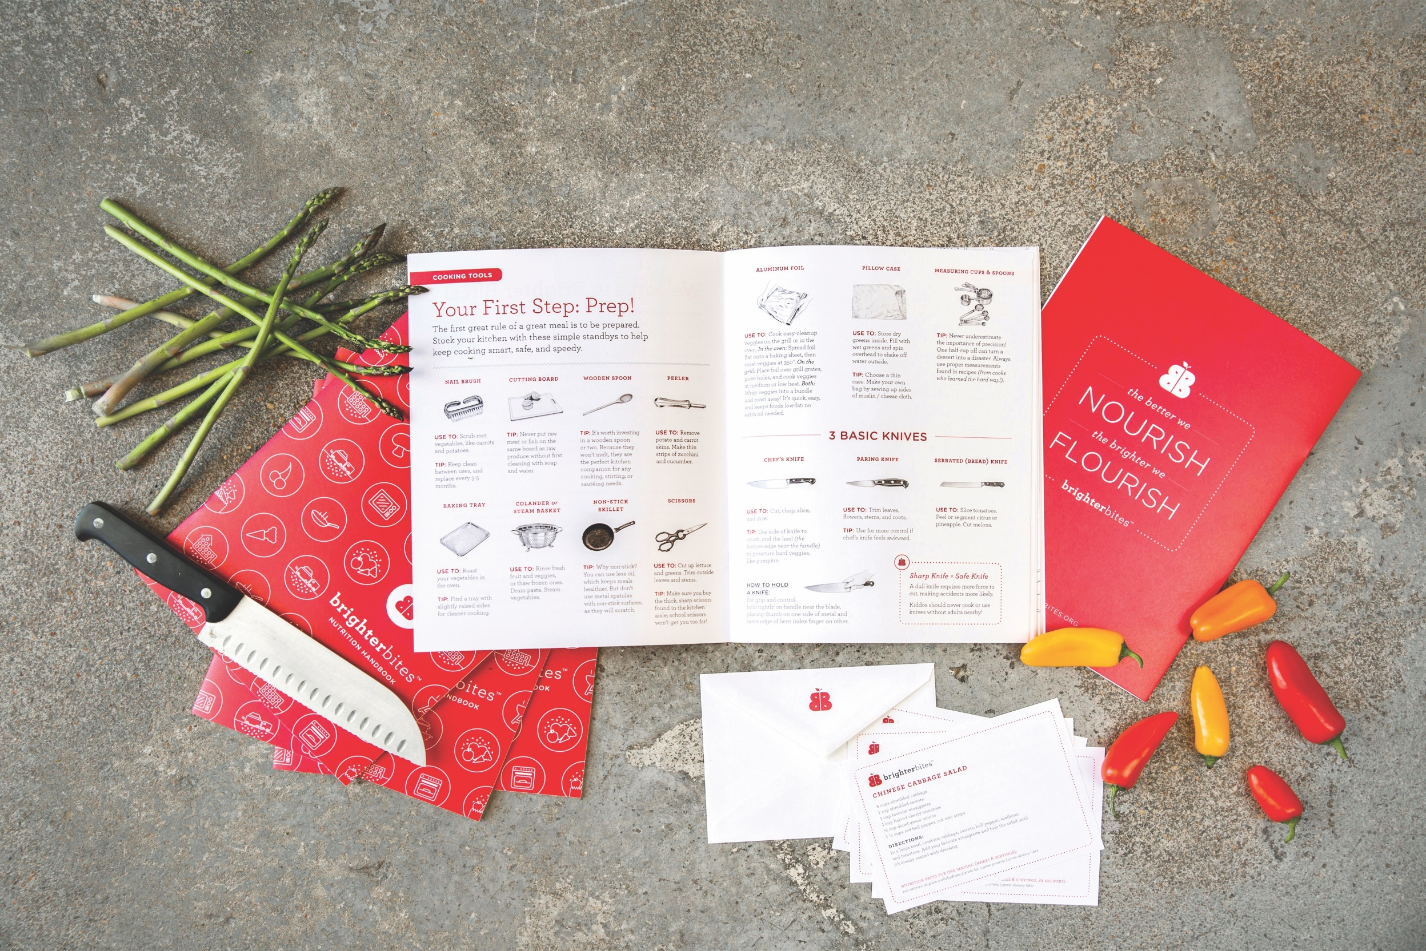

Slide 76
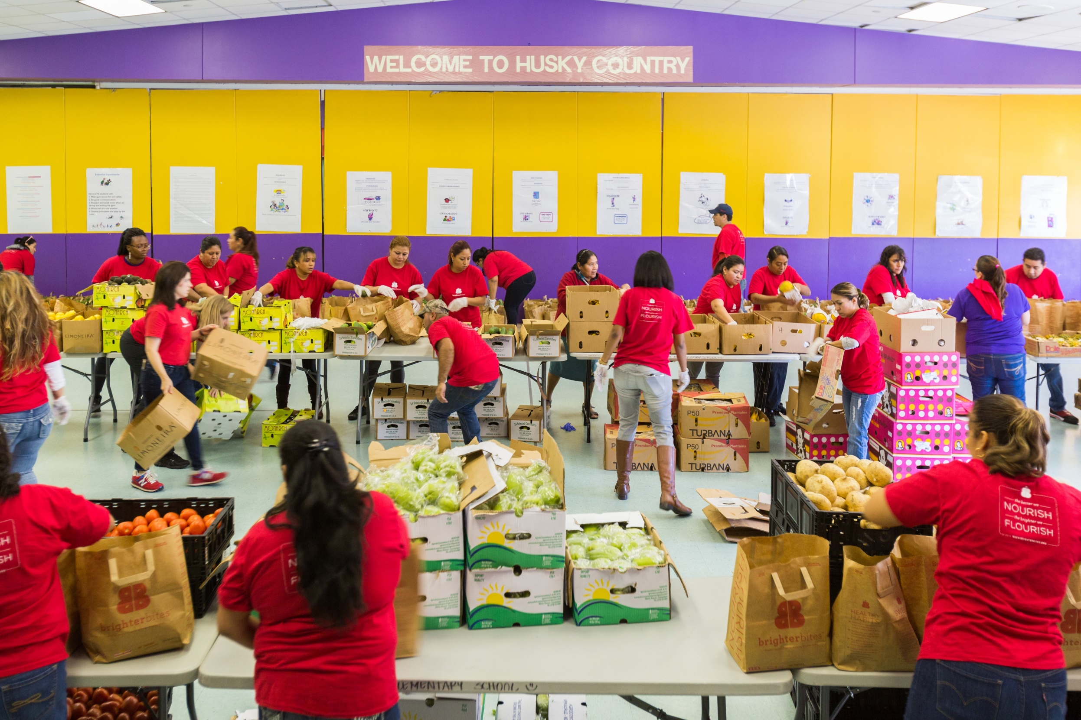
Notes:
Bagging

Slide 77
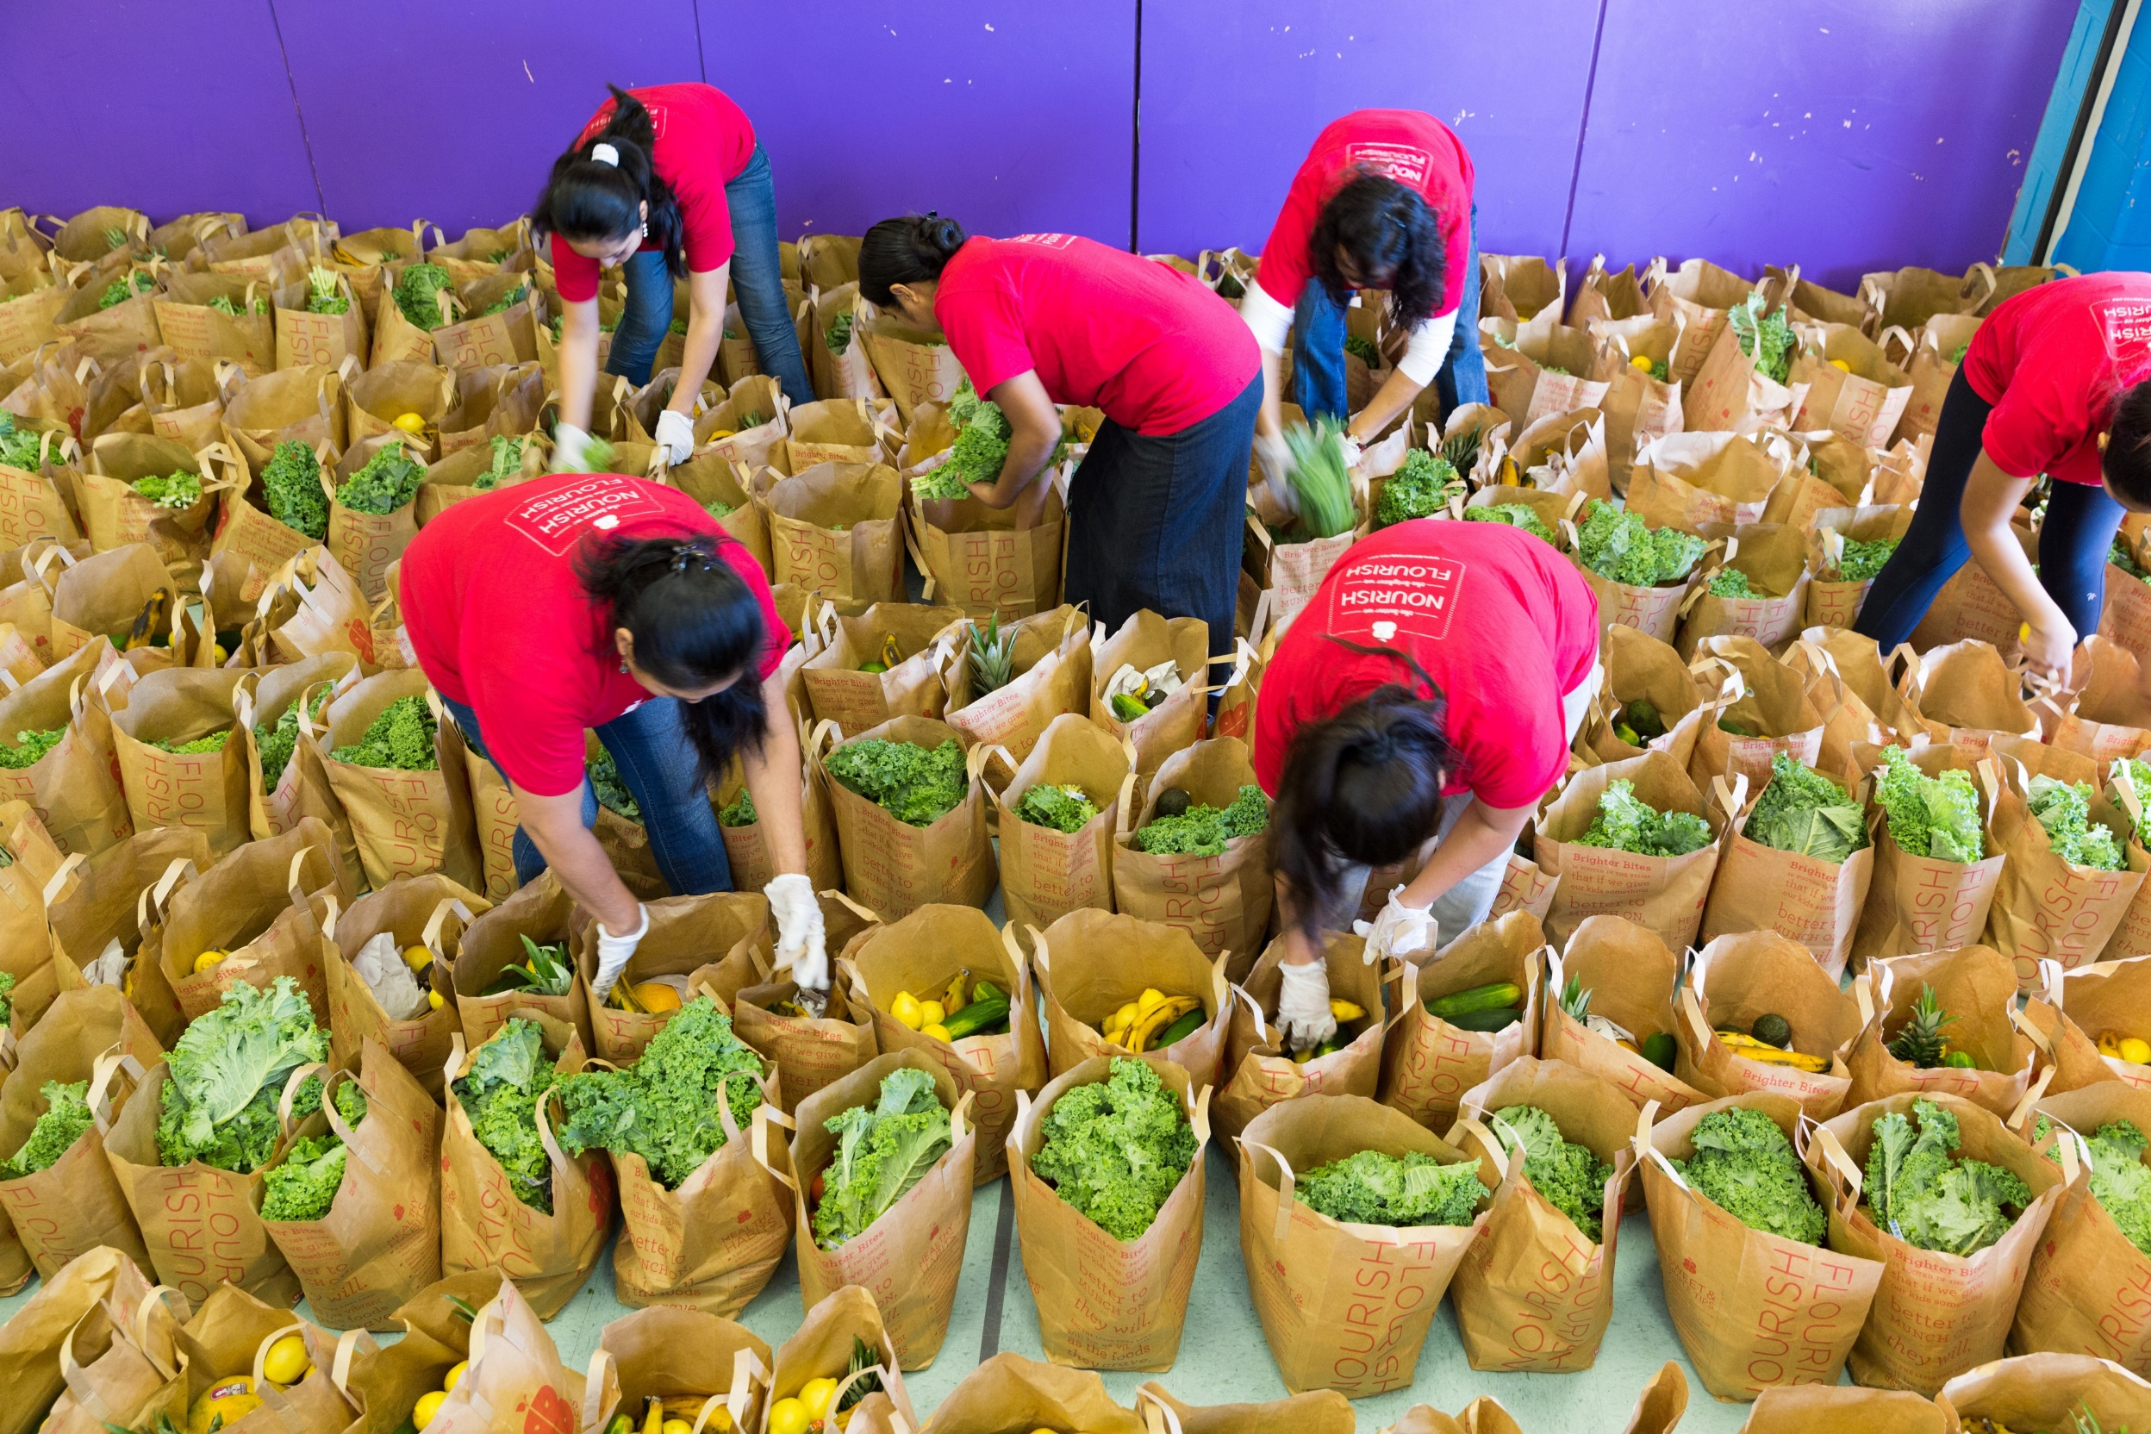
Notes:
Food Sampling

Slide 78
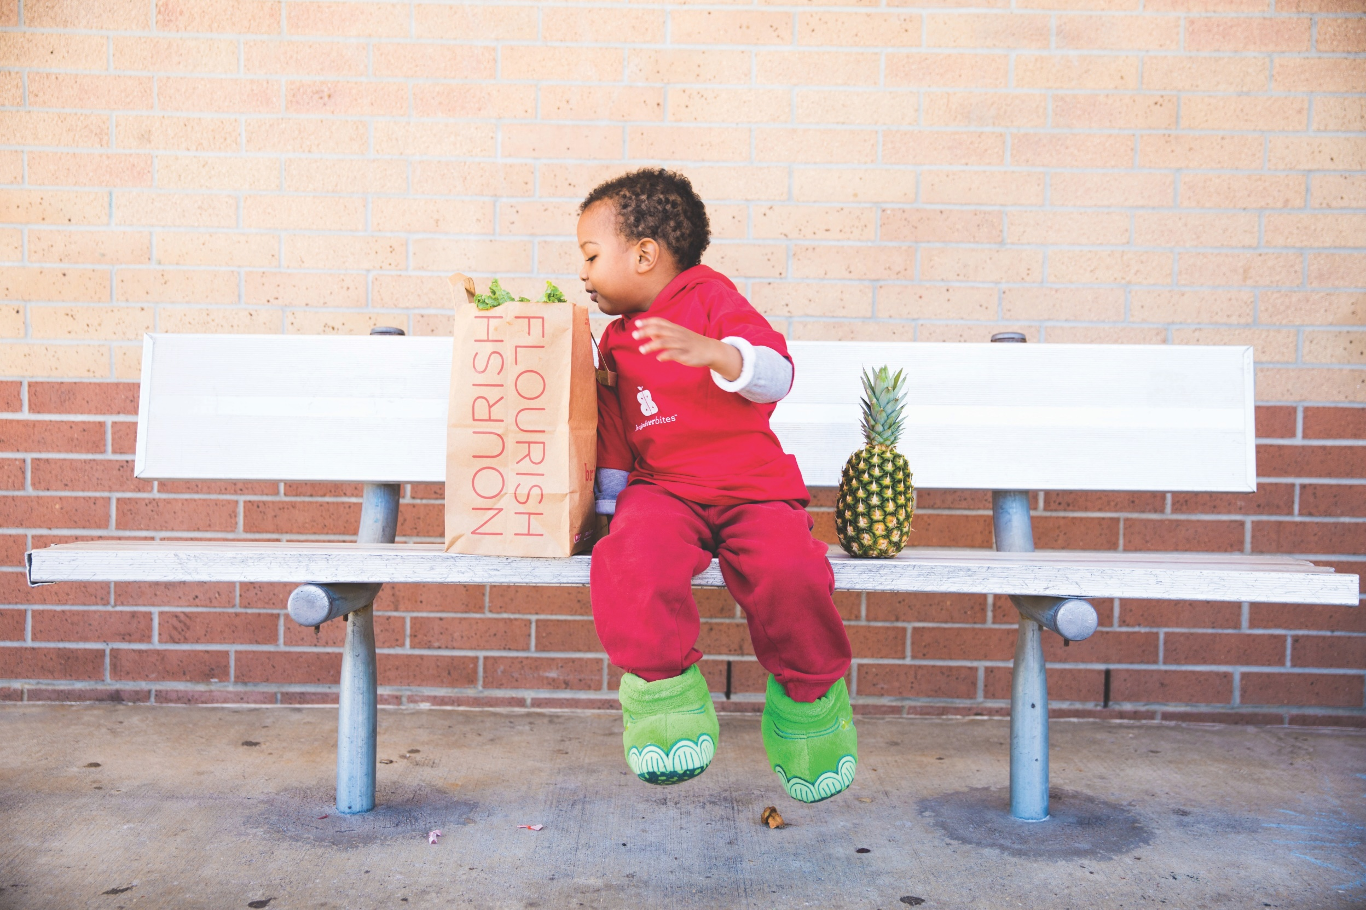
Notes:
Kids Engaging

Slide 79
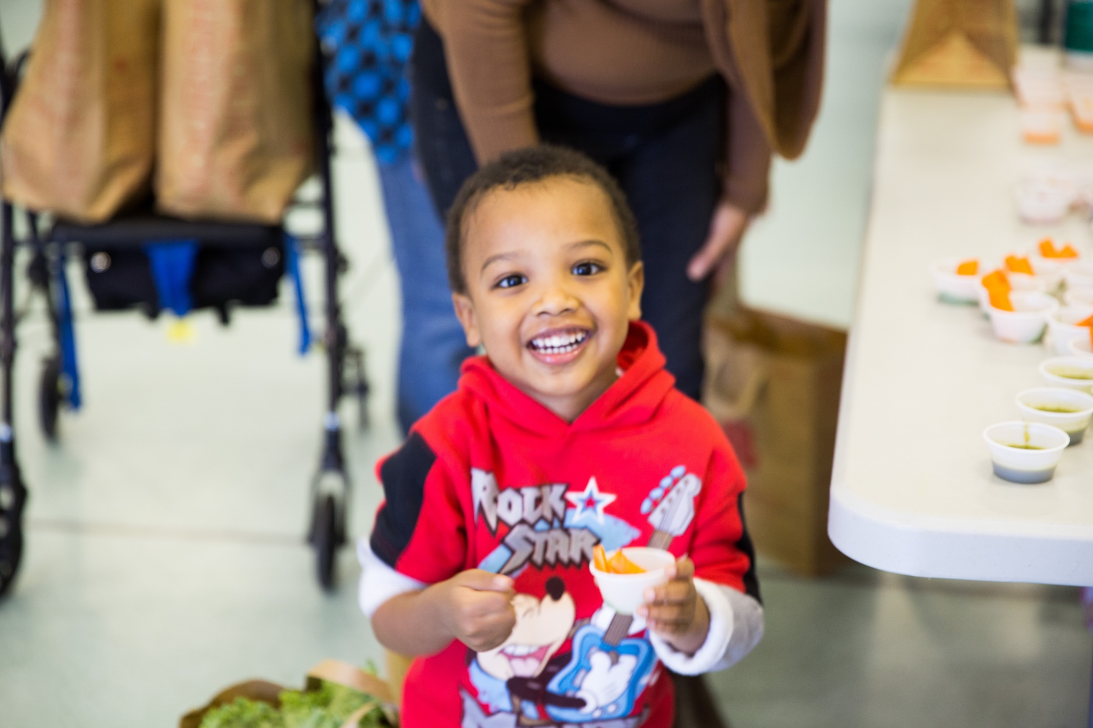
Notes:
Kids Engaging

Slide 80
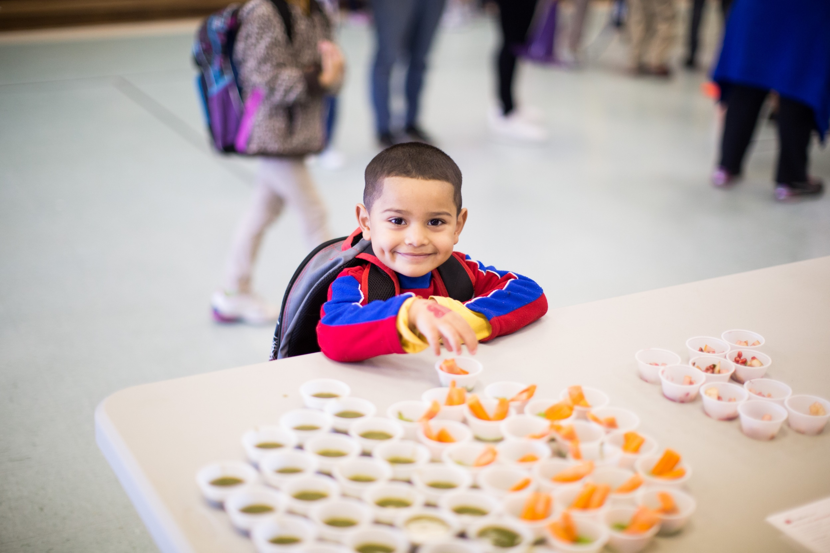
Notes:
Kids Engaging

Slide 81
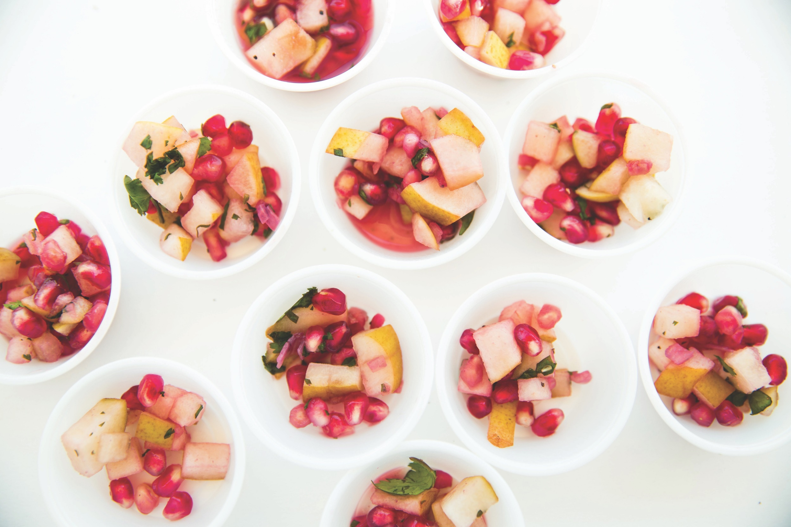

Slide 82
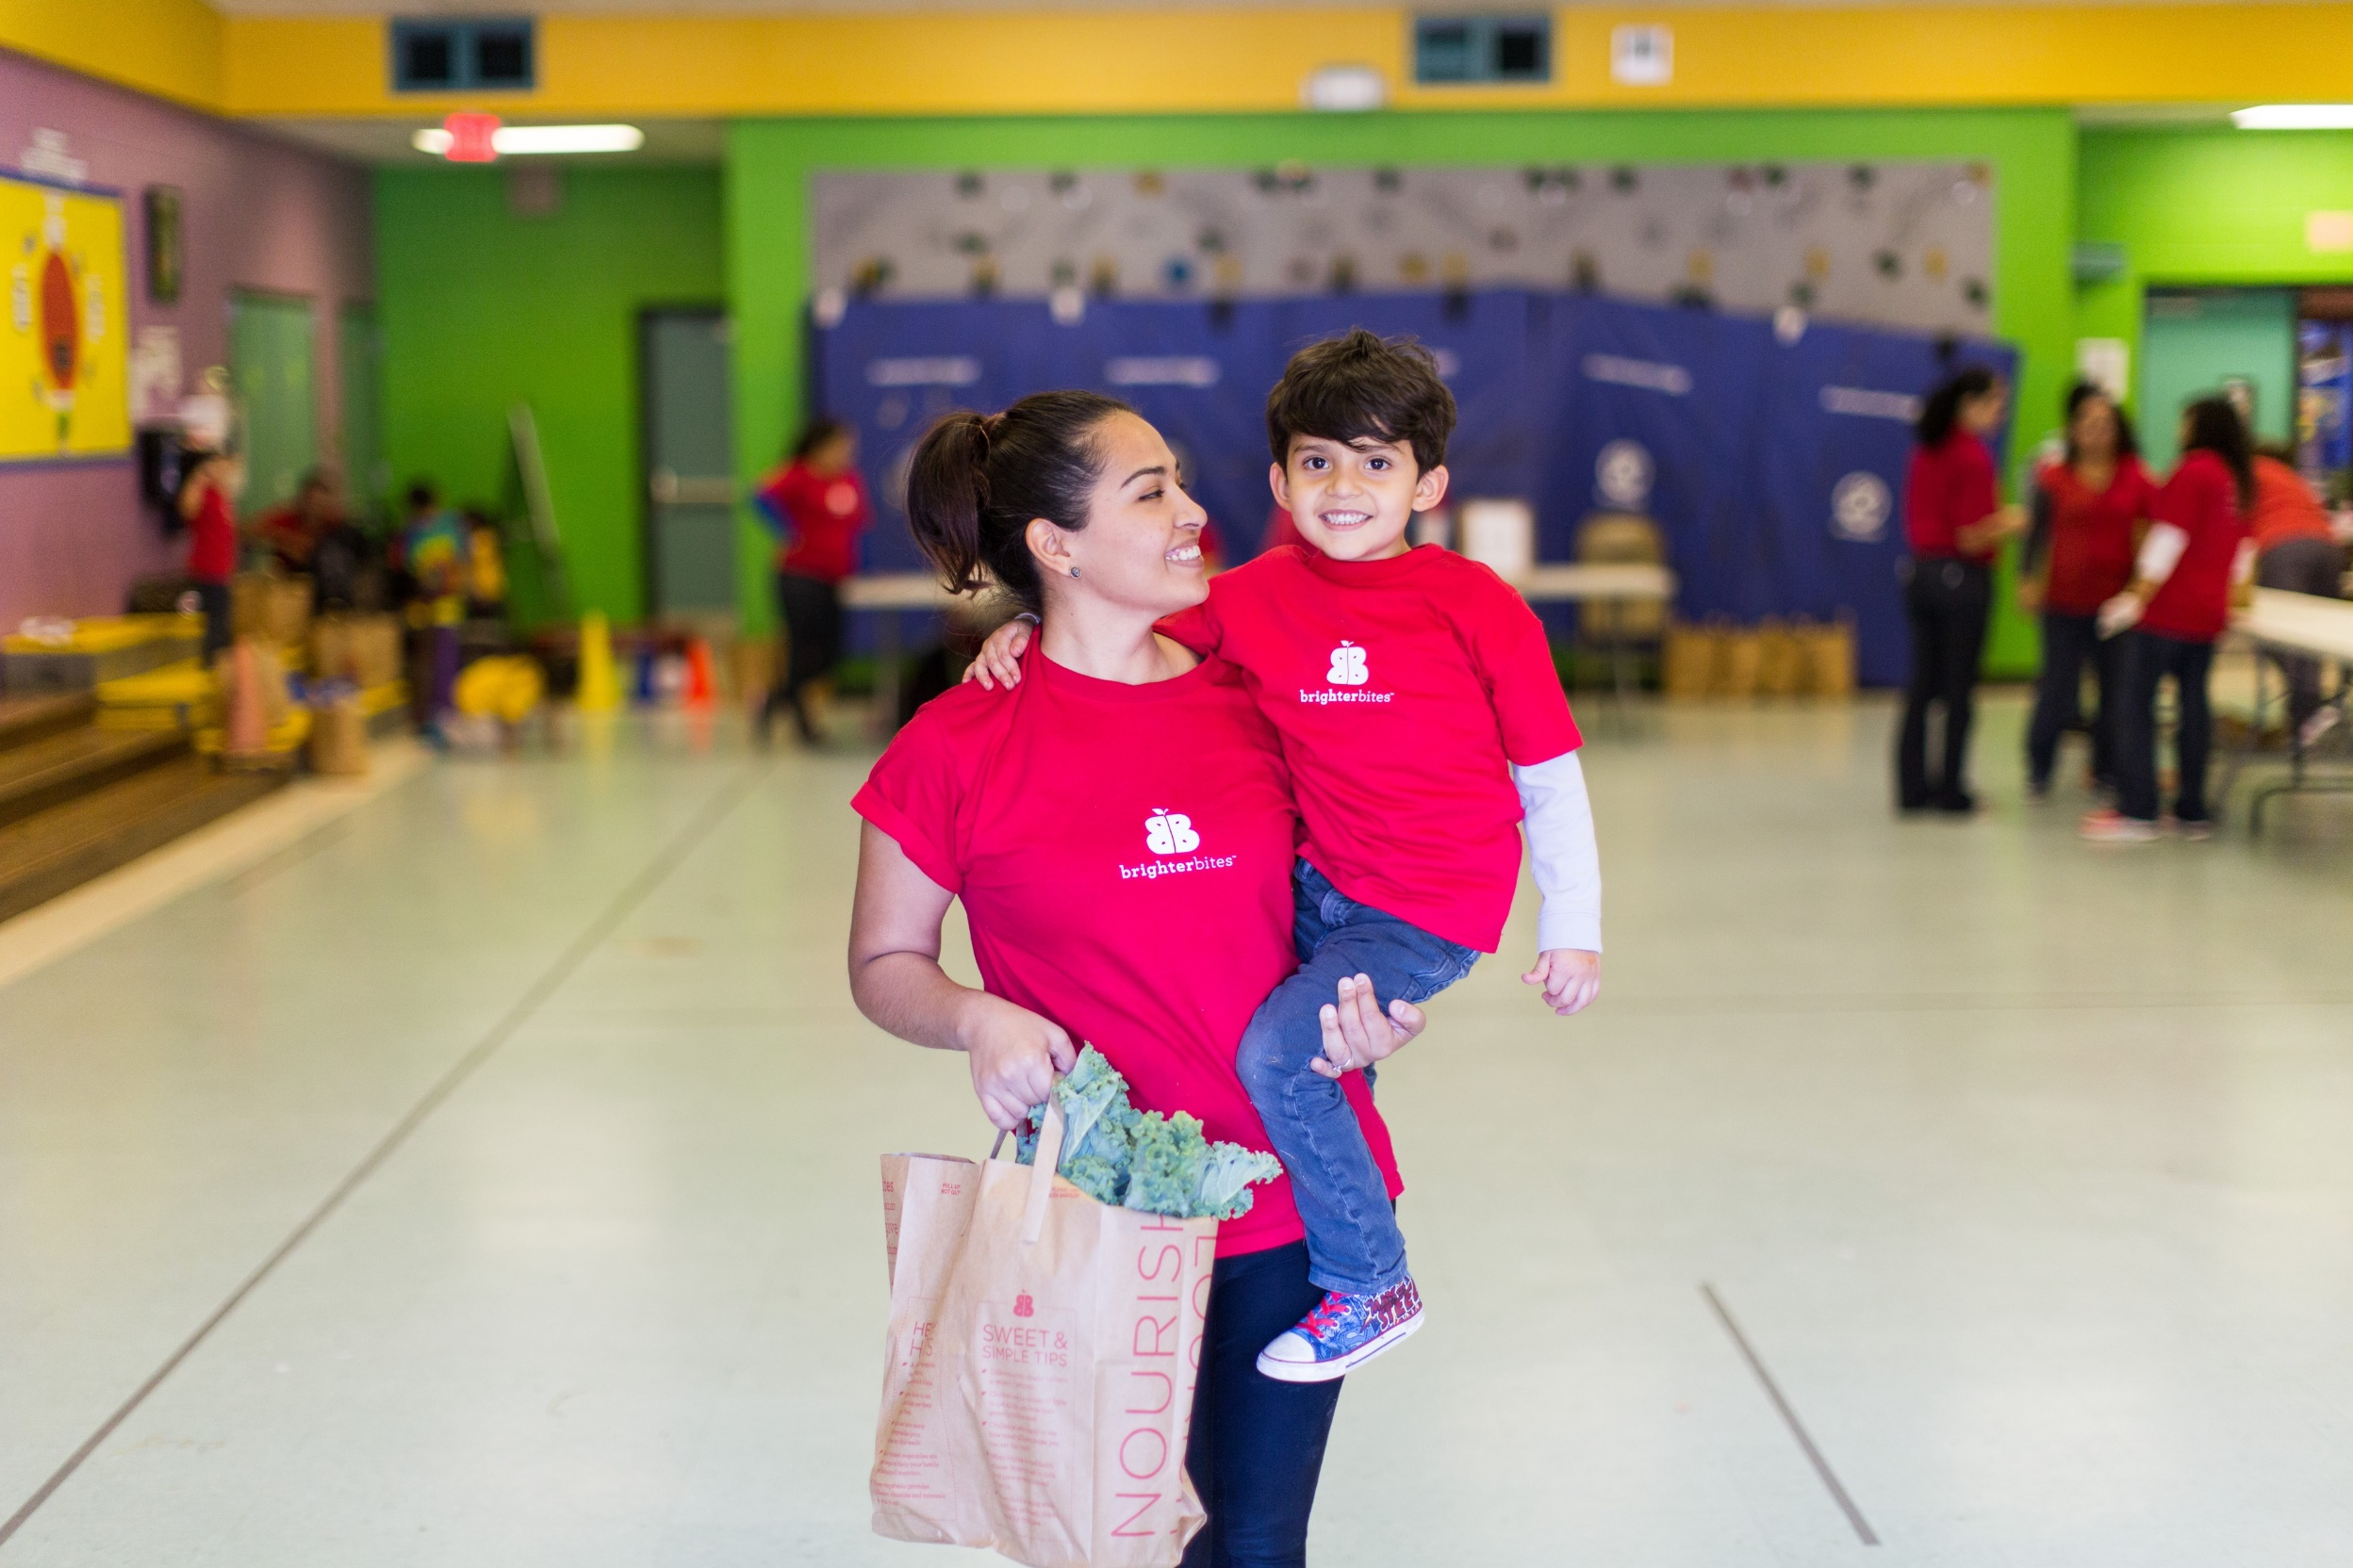
Notes:
Kids Engaging

Slide 83

Notes:
Logo slide

Slide 84
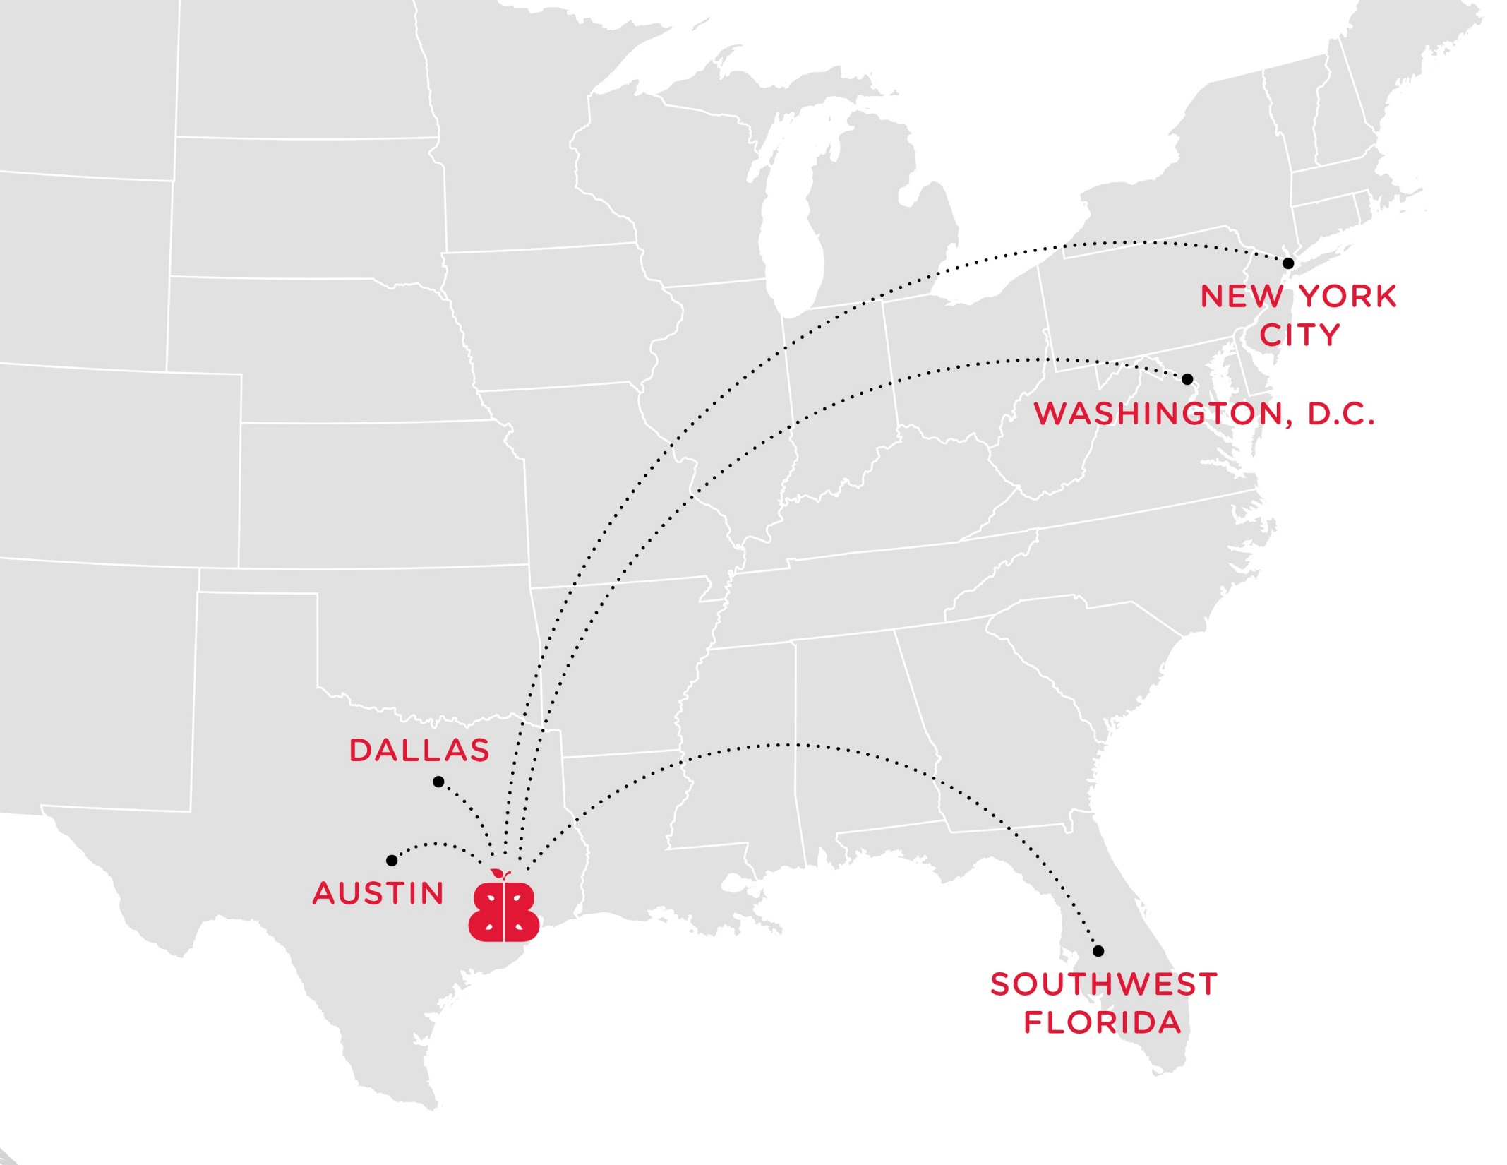
Notes:
Kids engaging

Slide 85




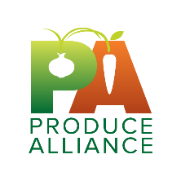














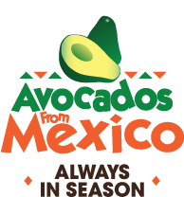


LEVERAGING THE STRENGTHS OF OUR PARTNERS

Slide 86














LEVERAGING THE STRENGTHS OF OUR PARTNERS

Slide 87
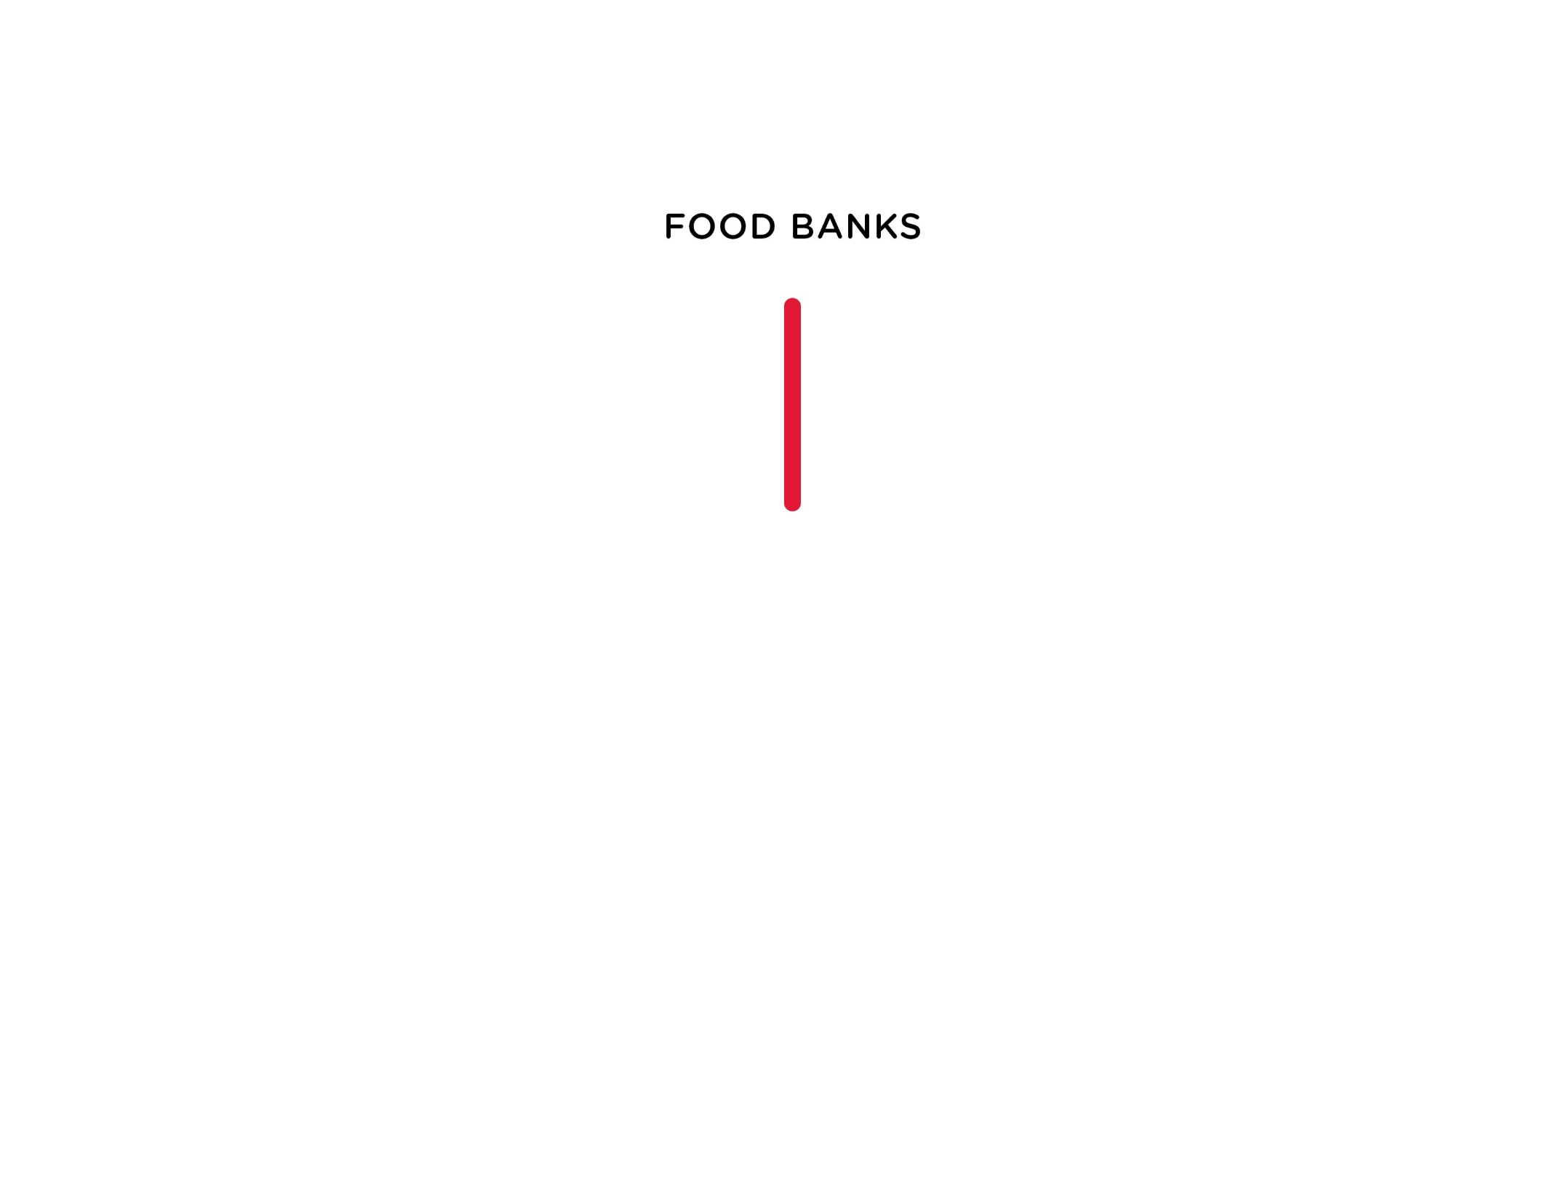

Slide 88
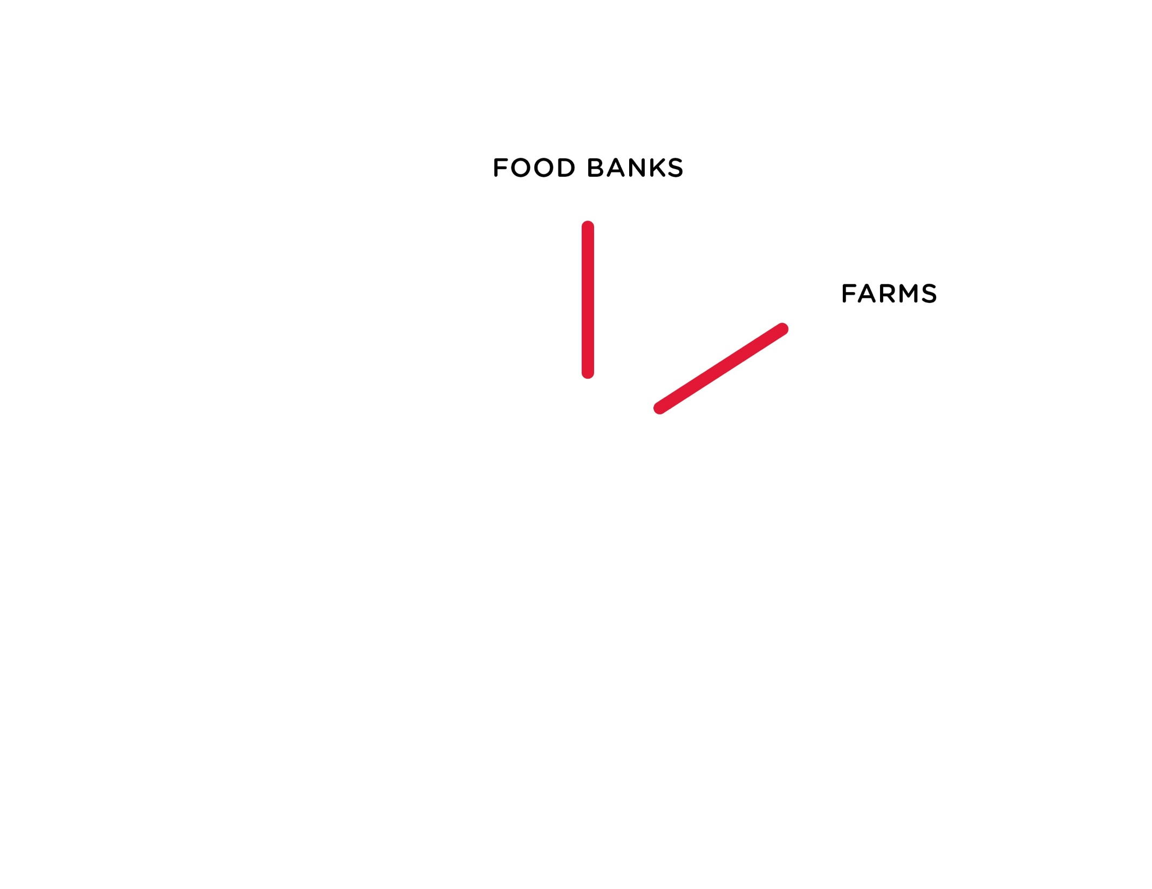

Slide 89
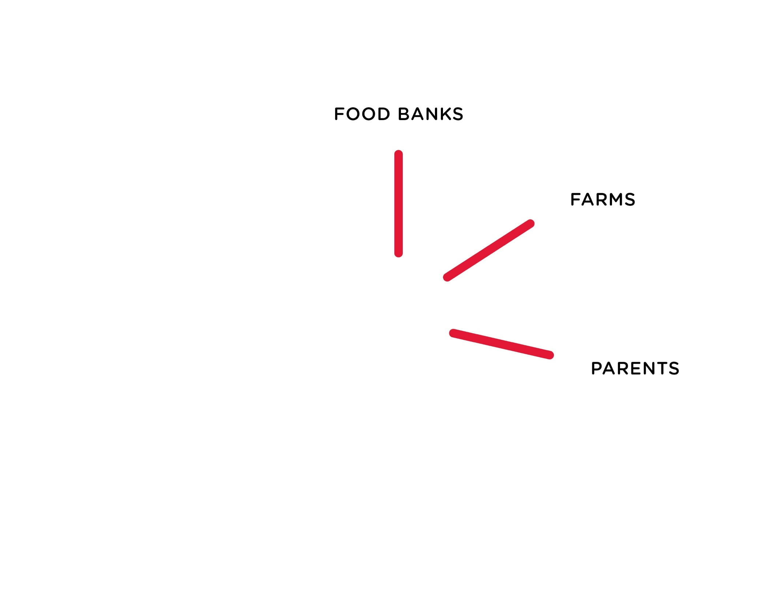

Slide 90


Slide 91


Slide 92


Slide 93


Slide 94


Slide 95

Notes:
Building Demand, Changing Behavior / Tracking the efficacy of the program in regards to health, shopping/eating habits, and parent participation in schools, and proving that we’re having sustainable impact.

Slide 96


Slide 97


Slide 98


Slide 99


Slide 100


Slide 101


Slide 102


Slide 104


Slide 106


Slide 107




HumanAnatomyChart.us
Notes:
In diagrams like these, every small label and connection counts because every single one can cause disease.
And here, is a scientifically accurate diagram of how my brain acts when I see too many of these diagrams… [NEXT]

Slide 108

Notes:
So how do you memorize these?

Slide 109


Let's try flash cards…
Netter’s Anatomy Flash Cards, 4th ed. Saunders.
Notes:
Flash cards are the first method people usually think of.
You know, of course, because I'm putting it first, that it's probably not the best idea. But it’s straightforward, and in many instances, gets the job done.
So this becomes a giant game of matching.
But flashcards are the definition of 2-dimensional, right?. You flip from one side to the other side. And information can be 3-4-5D; really information can have as many dimensions as it wants.
There have to be better ways.

Slide 110


Mnemonics
Notes:
One commonly used alternative to memorize lists is a mnemonic device [CLICK TO ADVANCE TO THIS SLIDE], which I’m sure many of you are aware of. So, here are two examples, the one on the left being preferable because it’s shorter and features a furry animal. The one on the right being a little more wordy and roundabout. But whatever helps you get through.
But these two techniques are still limited by how little information you can really condense into flashcards or mnemonics. What else can we do?

Slide 111




Common Association
First Aid for the USMLE Step 1. 2017.
Notes:
In other words, associating something that you’re learning with something that you already know by heart.

Slide 112


Better?
High Yield Neuroanatomy, 4th ed. Lippincott Williams & Wilkins
Notes:
Since the problem with flashcards was the two-dimensionality, only being able to connect one idea with one other idea, what about a 3D system to connect multiple ideas?
This would be something like a diagram or flow chart.
On the one hand, you can make flashcards for each one of these labels, and try very hard to commit each separate connection to memory. Or you can learn the system. It’s more compressible that way.

Slide 113
What am I doing here?
Notes:
So I’m sure you’re all thinking, wow, I’d love to spend the time memorizing all that. Where can I sign up for med school?
Well, actually, four+ years of memorization can get exhausting. Many times during the last three, I thought to myself, what are we accomplishing here, really? What is our goal?
And for almost two years, I really didn’t have any good answers.
It was then that we started clinical rotations. These are supposed to help solidify these flash cards, diagrams, mnemonics, systems, into real patients and real diseases.
Most importantly, you stick all the theoretical medicine with a face. And that is invaluable.

Slide 114





Cases
Notes:
Those patients that I saw, those narratives, are what made the medical knowledge stick. In the cases that we presented or published, I remember the details exactly—from their presenting signs/symptoms, to their diagnosis and treatment.
But more importantly, after seeing series of patients, we identify trends, and uncover healthcare issues. For example, at our flagship county hospital, we see the lack of access that certain populations face.
And this is important because I believe that it is also our job to be on alert for wide-ranging healthcare issues.
I got into the habit of advocating for these, when I saw them. I wanted to tell those stories that I’d heard, and advocate for the issues at hand. By narrating, the facts became easier to remember.

Slide 115

I remember this!
Notes:
There’s some space for creativity here. Luckily, there are multiple media through which to tell stories. We can write—(for a research publication, for a blog, for a newsletter), we can present (at a conference, a research meeting, or informal discussions with colleagues), and we can create (the sky’s the limit here).
Advocacy, creating those narratives and bringing them into the spotlight, stuck them permanently into my memory. This, I think, is the best way to remember. Uncover the issues that really matter in your field, and narrate them. And be creative—because we all have it in us. It’s easy to narrate for advocacy because those narratives are pretty much handed to us.
Not only do we draw attention where attention is due, we also get the bonus of having the important facts stuck in our memory. All without the painful memorization of flipping back and forth through flashcards.

Slide 116
Notes:
But, let’s take this concept back to the goal we started with, memorization.
Not only can narrative techniques help us to advocate the important issues, we can apply these techniques to plain memorization of the mundane items. Sometimes, the narratives aren’t given to you.

Slide 117
Grocery List
Hamburger patties
Buns
Lettuce
Tomatoes
Onions
Pickles
Cheese
Grapes
Sea salt
Flour
Gummy bears
Notes:
Let’s take an example together. A very simplistic demonstration of how you can apply this idea of creating a narrative to remember.
Let’s say you needed to commit some list to mind, a grocery list. You promised some hungry friends that you’re going to make hamburgers for them on Sunday, and you only have time for one trip to the supermarket, so you can’t forget anything.
Here’s a list of possible items that you want to remember on the go, hamburger supplies with a few random items thrown in as well
Using this list, let’s apply how we might be able to create a narrative.

Slide 118

Grocery List
Hamburger patties
Buns
Lettuce
Tomatoes
Onions
Pickles
Cheese
Grapes
Sea salt
Flour
Gummy bears
CHOP
Notes:
We’ll start with the most important parts of our grocery list, the things that we said we would definitely need: the hamburger supplies.
If we do a bit of rearranging, we notice we can create something of a mnemonic here with some of these items: CHOP from cheese, hamburger patties, onions, pickles.
Let’s start by building our narrative around this. CHOP reminds me of cooking, so that theme would also help to make it stick in our brain.

Slide 119

Grocery List
Hamburger patties
Buns
Lettuce
Tomatoes
Onions
Pickles
Cheese
Grapes
Sea salt
Flour
Gummy bears
Notes:
That leaves three more items on our essentials list: Buns, Lettuce, and Tomatoes.
Now, we can take the shortcut, and have our image of the chef creating a BLT, and remember that way.
For the purposes of demonstration, let’s get a little more narrative with this example. It looks like, from the ingredients this chef has on the chopping block, that he might be making something with a lot of vegetables, something like a casserole, let’s say. [CLICK]
Now, from what I know, casseroles are hassle-free because you rely on the oven to do pretty much all the work, right? So let’s take the letters B, L, and T, and bake that into the process of making a casserole. In our case, the letters B, T, L will stand for bake – time – leave, for the intuitive steps that you’d take when you put a casserole into the oven.

Slide 120

Grocery List
Hamburger patties
Buns
Lettuce
Tomatoes
Onions
Pickles
Cheese
Grapes
Sea salt
Flour
Gummy bears
Notes:
Now, we are left with four items to account for. So let’s continue the narrative.
First of all, let’s deal with the gummy bears easily by making our heretofore faceless chef a bear. Gummy bears are pretty essential to my diet to let’s center that in our narrative, making sure we don’t forget this important item.

Slide 121

Grocery List
Hamburger patties
Buns
Lettuce
Tomatoes
Onions
Pickles
Cheese
Grapes
Sea salt
Flour
Gummy bears
Grizzly State Fair
Notes:
We’re left with three more items. Let’s think.
What is our chef creating this casserole, that we’re going to bake-time-leave, for? Well, let’s think about this logically, like we’ve been doing all along. Our chef is a grizzly bear, it looks like, so he’s probably creating this masterpiece for the Grizzly State Fair…GSF, or Grapes, Sea salt, Flour. [CLICK]
What I like about this mnemonic is that it also sounds like the things it stands for, making the memory hook stronger. Grizzly can easily hook you to Grapes, both with the Gr sound
Sea salt to State, both with strong s and t sounds
And Flour to Fair, both start with F and end with R.
So we end up with a story, of our CHOPping (standing for cheese, hamburger patties, onions, pickles), BEAR (for gummy bears) chef making a casserole by Baking-Timing-Leaving (reminding us of buns, tomatoes, and lettuce), for the Grizzly State Fair (grapes, sea salt, and flour).
Now I wouldn’t recommend doing this with all your grocery lists, but for the important things that you need to memorize quickly and reliably, creating a narrative is handy.

Slide 122
Create, Narrate, Memorize
Notes:
The bottom line.
Whatever field you’re in, identify the overarching concepts, the things that are really important.
Create a narrative to remember.
If it’s an issue of importance, tell others about it. Advocate.
And the facts, the memorization, should come much more easily.

